Slide 1

Comprehensive Design and Analysis Project
IT4010 | 2021
Enhancing
Online Teaching & Learning Experience
by Using
Multiuser Virtual Environment
2021-065

Slide 2
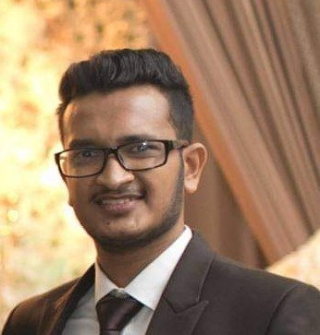
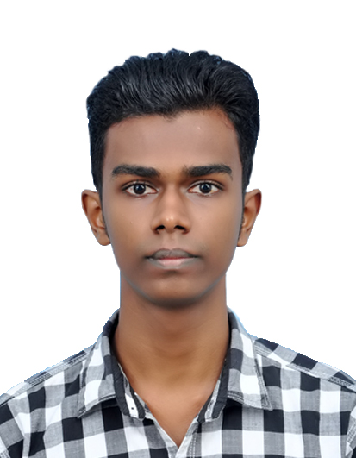
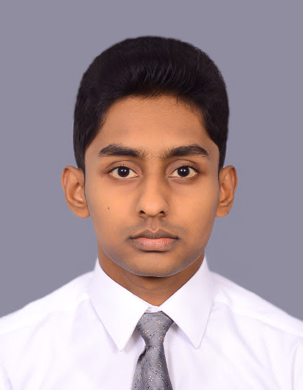
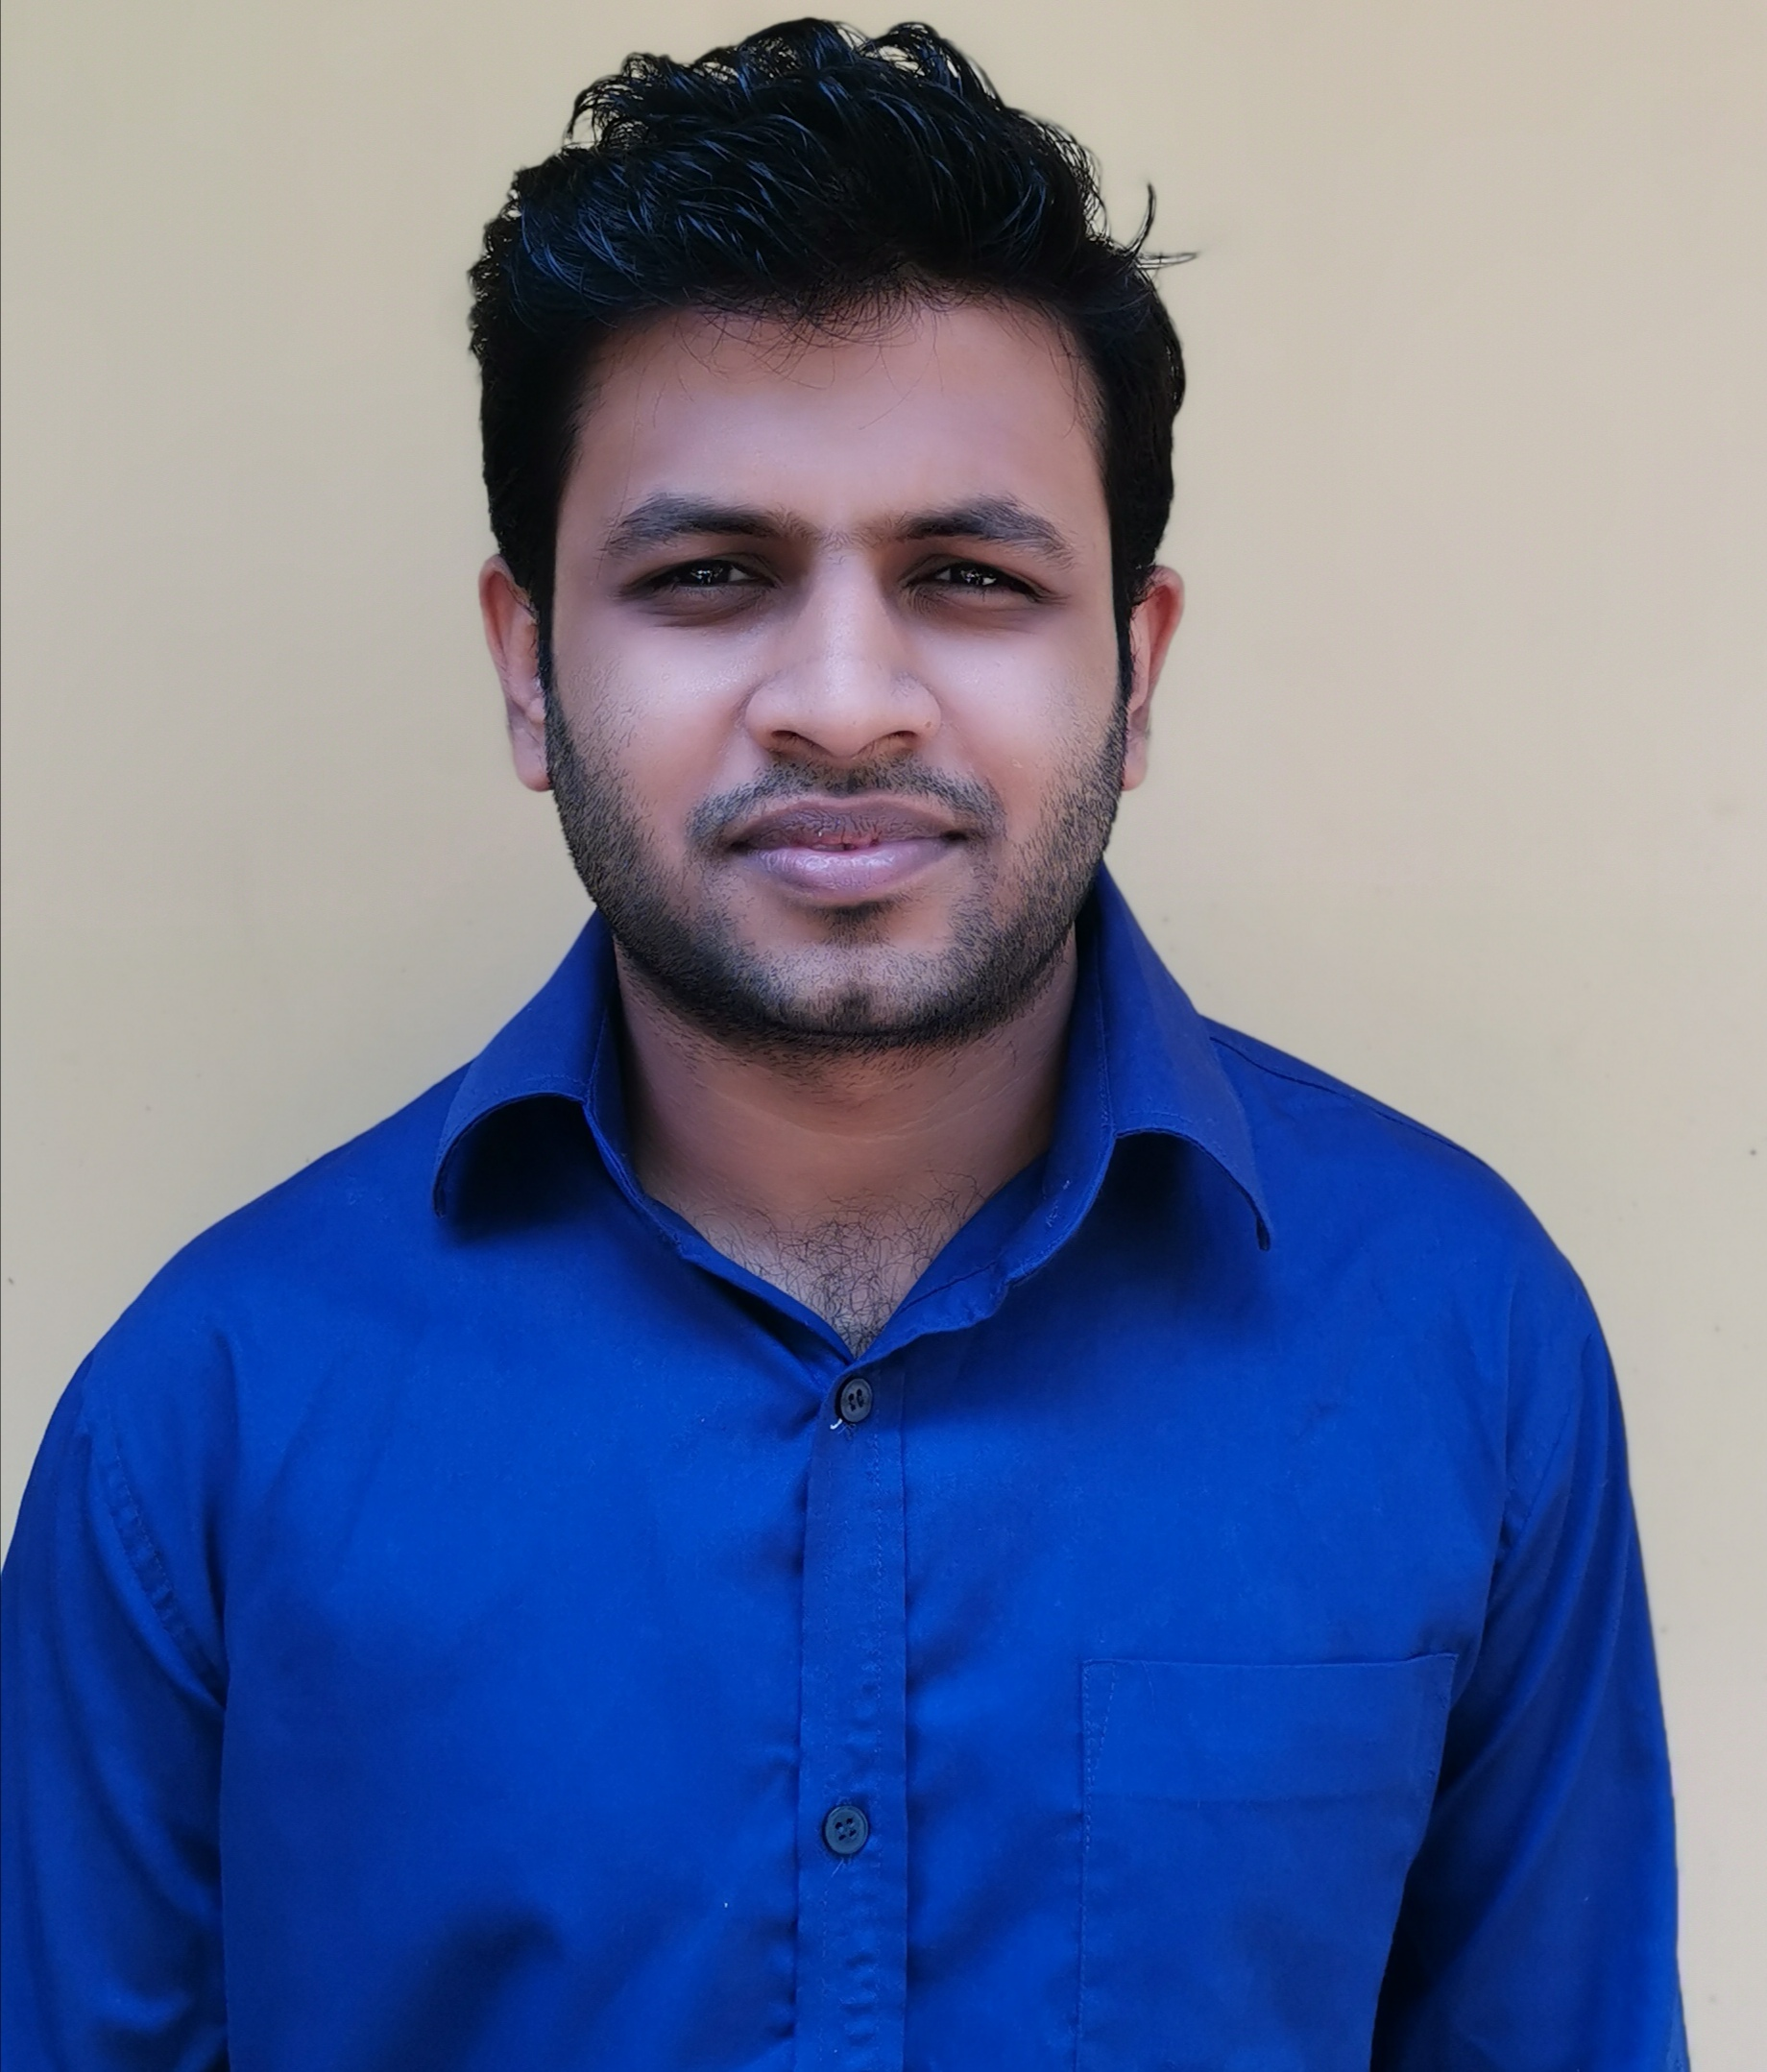
Our Team
Supervisor | Dr. Nuwan Kodagoda
Co-supervisor | Ms. Kushnara Suriyawansa
IT18006544
IT18001112
IT18009132
IT18007848
Perera H.D.D.S
Tharaka W.C.M.K.
Dilanka R.M.T.
Rathnayake R.H.C.S.

Slide 3
IT18006544
Perera H.D.D.S.
B.Sc. (Hons) Degree in Information Technology Specialization in Software Engineering

Slide 4

Introduction to Overall project
IT18006544
Effect of Covid-19 in education sector
Perera H.D.D.S
Since video conferencing tools are not intended for teaching and learning purposes, overall learning and teaching experience has become less productive
Shared questionnaire among undergraduate
01

Slide 5

Research Question
IT18006544
How to enhance online learning and teaching experience ?
Perera H.D.D.S
02

Slide 6
Objectives
Main Objective
IT18006544
Perera H.D.D.S
Enhancing Online Teaching and Learning Experience.
Sub Objective 1
Analyzing the students’ attentiveness to the lecture and help them to keep their attention.
Sub Objective 2
Reducing students' isolation during online lectures and enabling the collaborative learning using multiuser virtual learning environment.
Sub Objective 3
Providing a near-real time, simulated student behavioural view of the students.
Sub Objective 4
03
Help students by providing well-organized lecture note using optimized lecture transcription and related visual figures of the lecture

Slide 7
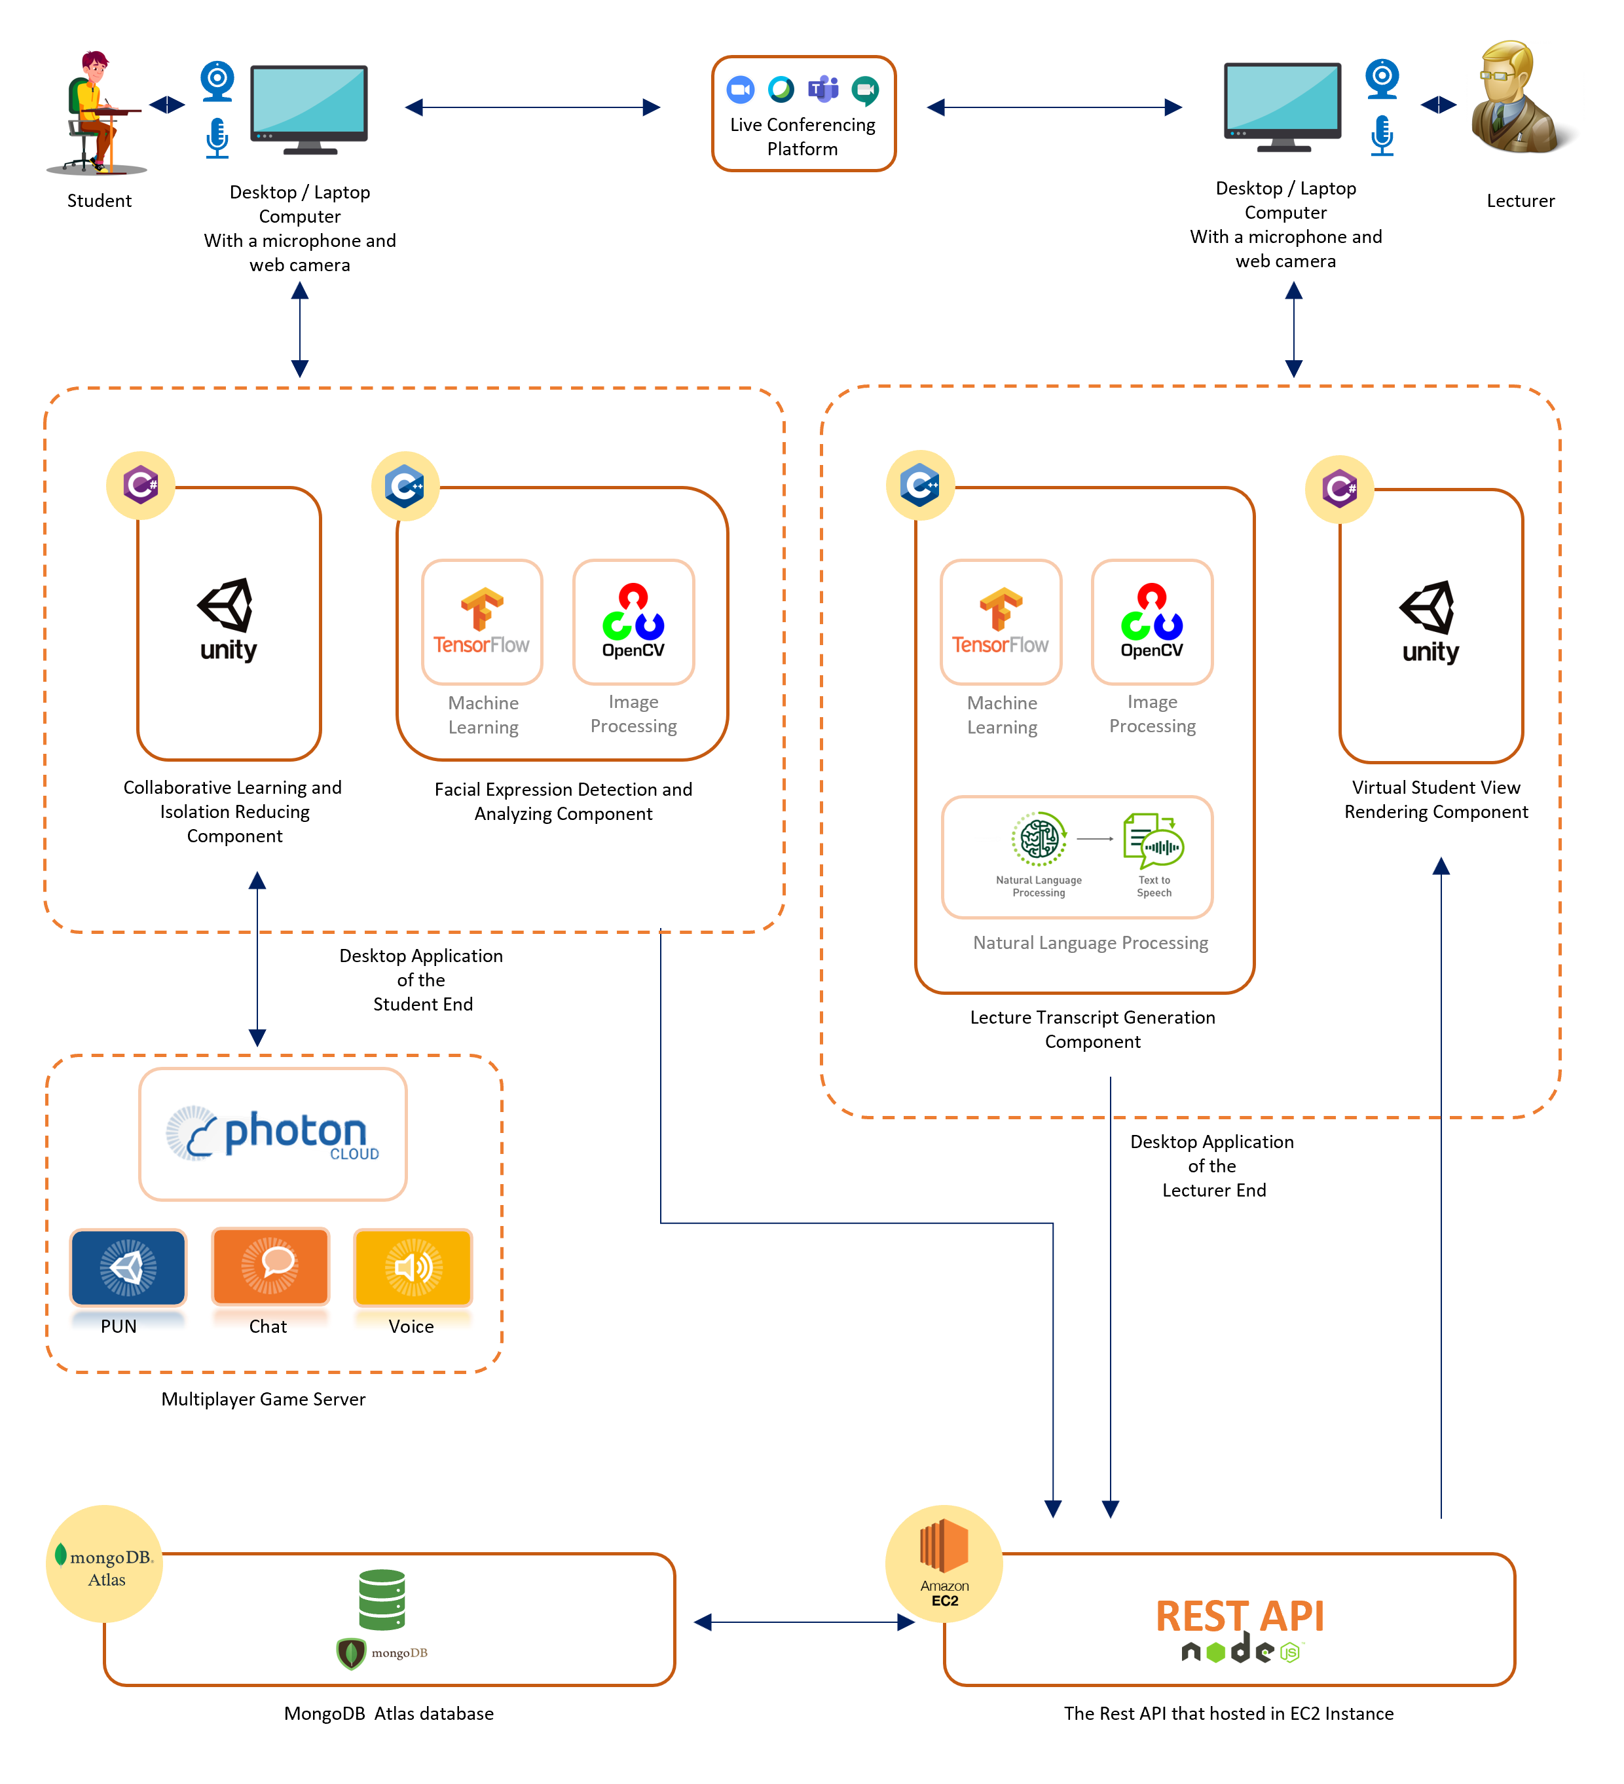
Overall System Diagram
IT18006544
Perera H.D.D.S
04

Slide 8
SUB OBJECTIVE - 01
Analyzing the students’ attentiveness to the lecture and help them to keep their attention

Slide 9

Research Question
How to capture student attention level during Online lectures ?
IT18006544
Perera H.D.D.S
How to improve student attention level during online lectures ?
05

Slide 10
Objectives achieved
Use of deep learning models to train and capture student’s facial emotion
IT18006544
Perera H.D.D.S
Functional dashboard to provide information regarding class and individual
student
Use of edge computing technique to analyze the captured emotions
Optimized algorithm to provide feedback to students periodically.
06

Slide 11
System, Software and Personnel Requirements
System Functional Requirements of the Project
IT18006544
Perera H.D.D.S
Capturing and analyzing student’s attention through facial emotions.
Suggesting methods for lecturer to increase student attentiveness
Periodically notifying student about their attentiveness
Allowing lecturer to view overall and individual student attentiveness
System Non-Functional Requirements
Security
Performance
07

Slide 12

Risks and solutions
Student privacy
IT18006544
Perera H.D.D.S
Use of edge computing architecture
Capturing and processing facial emotions in client side.
Sending only the processed information to the server side.
Need of stable connection
Data bandwidth usage
08

Slide 13
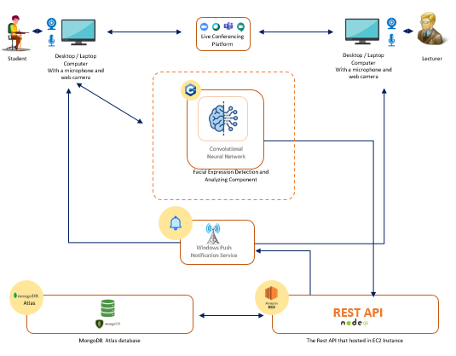
System Architecture
System Architecture Diagram
Technologies Used
IT18006544
Perera H.D.D.S
Python
Node JS / Express JS
AWS EC2 Instance
Google Collab
Window Push Notification Service
Convolutional Neural Network
09

Slide 14
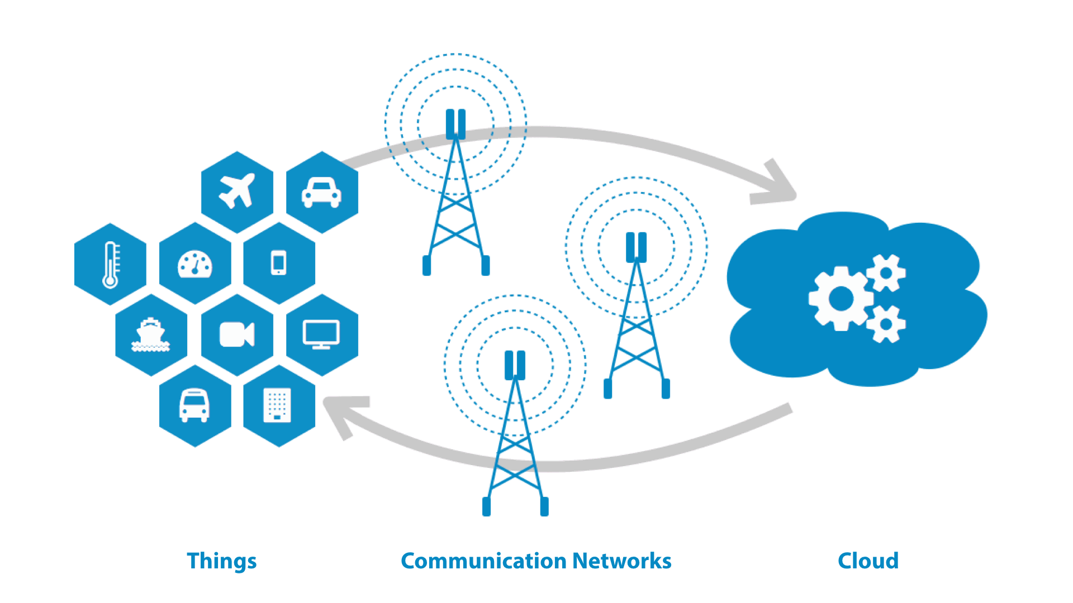
System Architecture
Why edge computing architecture over Cloud Computing ?
IT18006544
Perera H.D.D.S
Privacy and Security
Reduce bandwidth
Reduce server workload
10

Slide 15
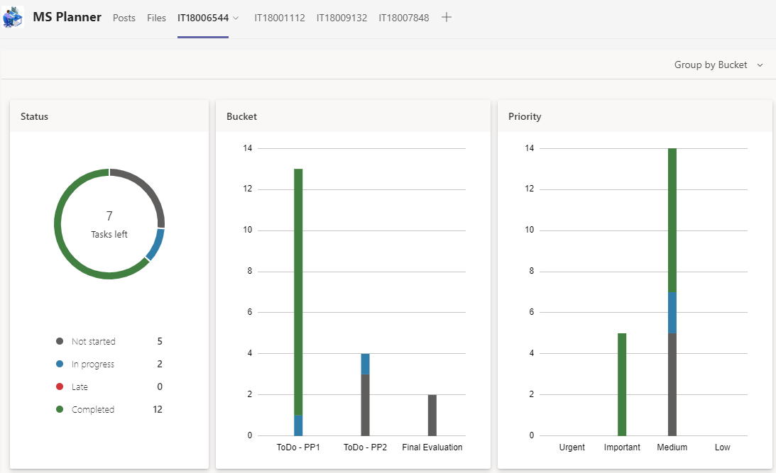
Progress up to Progress Presentation - 01
IT18006544
Perera H.D.D.S
11

Slide 16
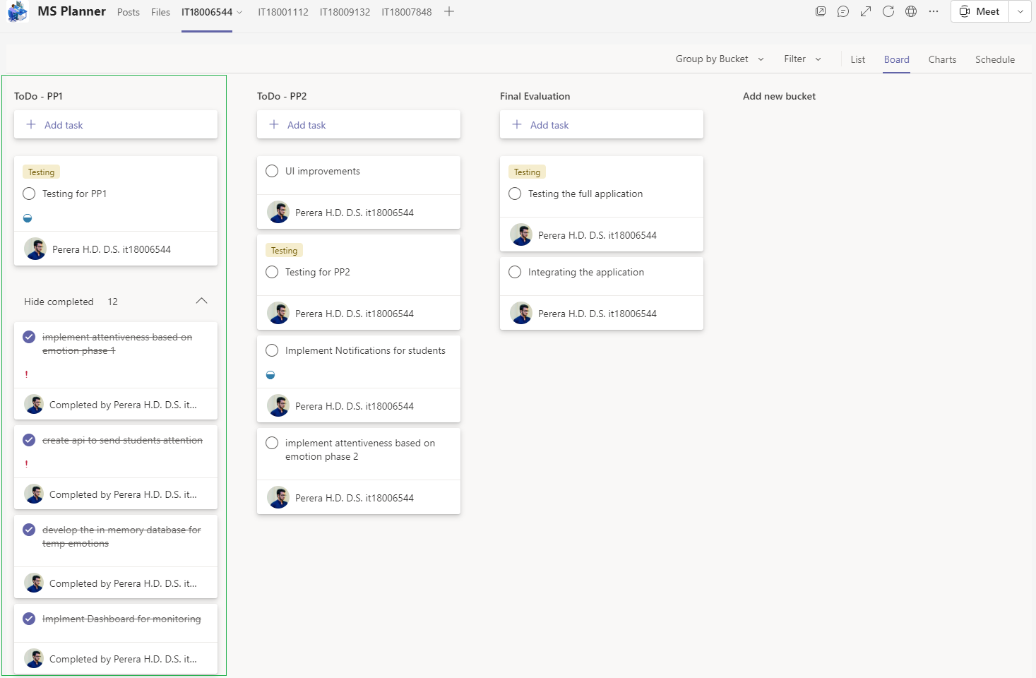
Progress up to Progress Presentation – 01 Contd.
IT18006544
Perera H.D.D.S
12

Slide 17
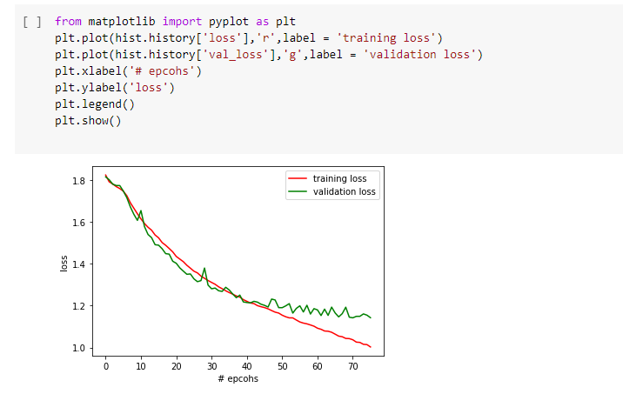
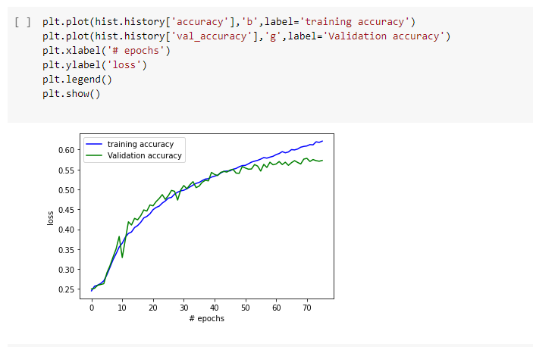
Progress up to Progress Presentation – 01 Contd.
IT18006544
Perera H.D.D.S
Accuracy = 60%
13

Slide 18
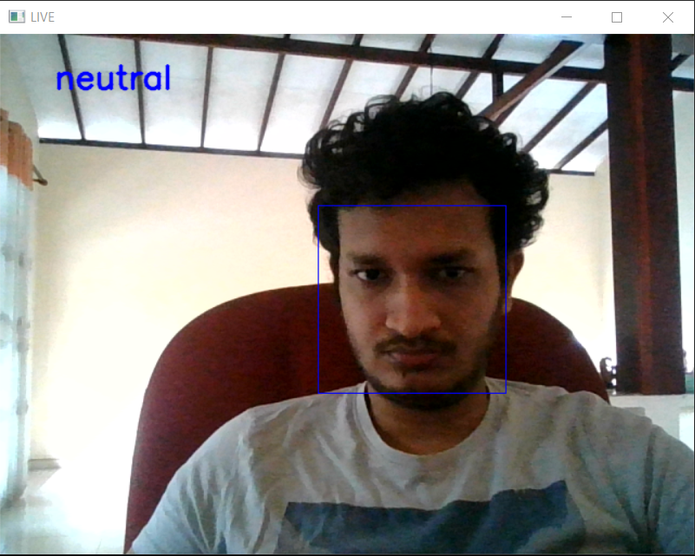
Progress up to Progress Presentation – 01 Contd.
IT18006544
Perera H.D.D.S
14

Slide 19
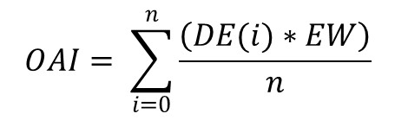
Progress up to Progress Presentation – 01 Contd.
Equation to calculate the Attention Index and Overall Attention Index
IT18006544
Perera H.D.D.S
$$AI=DE∗EW$$
Dominant Emotion | Emotion Weight
Neutral | 0.9
Happy | 0.6
Surprised | 0.3
Fear | 0.4
Disgust | 0.25
Sad | 0.2
Anger | 0.2
$$OAI= \sum_{i=0}^{n}{\frac{\left(DE(i)∗EW\right)}{n}}$$
Where :
AI = Attention Index
DE = Dominant Emotion
EW = Emotion Weight
OAI = Overall Attention Index
n = Number of iterations
15

Slide 20
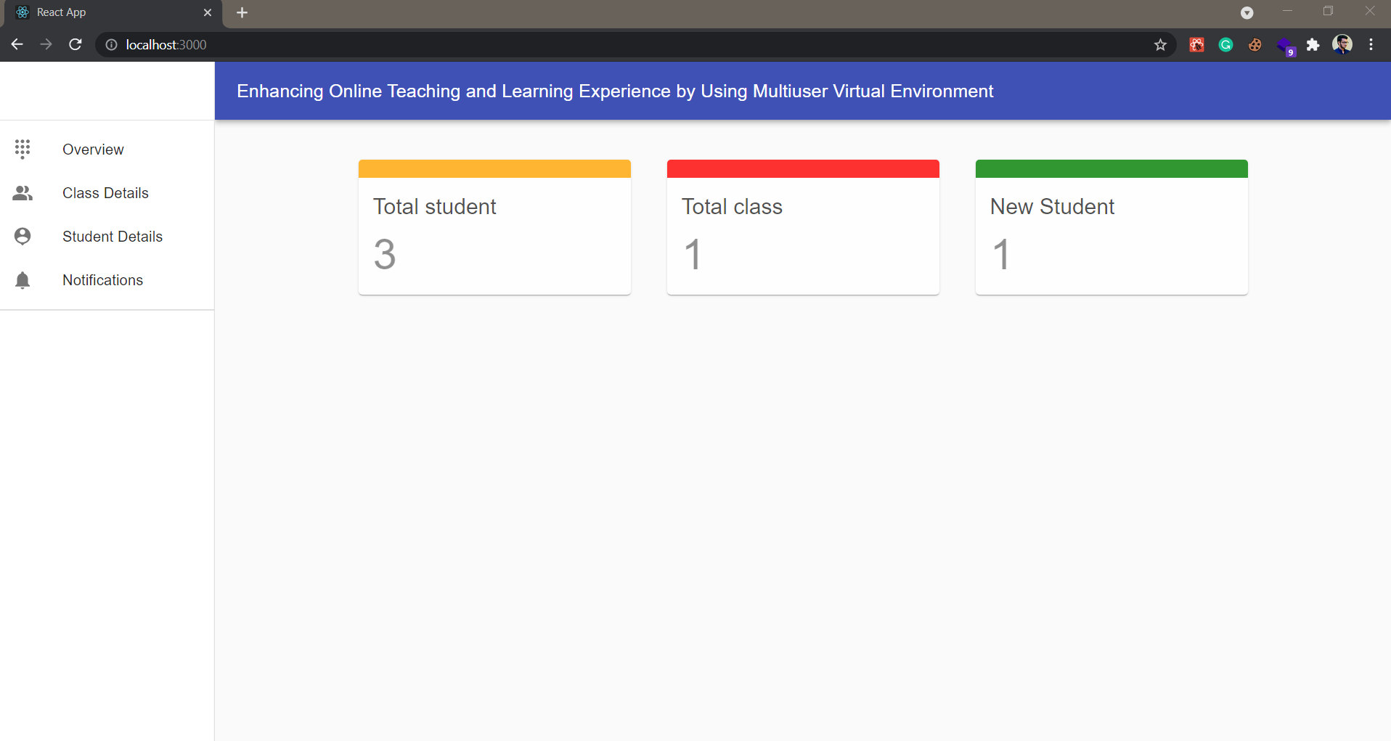
Progress up to Progress Presentation – 01 Contd.
IT18006544
Perera H.D.D.S
16

Slide 21
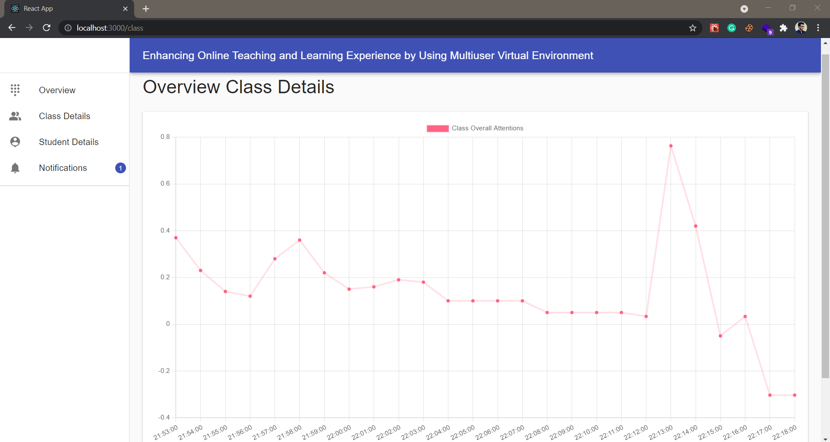
Progress up to Progress Presentation – 01 Contd.
IT18006544
Perera H.D.D.S
17

Slide 22
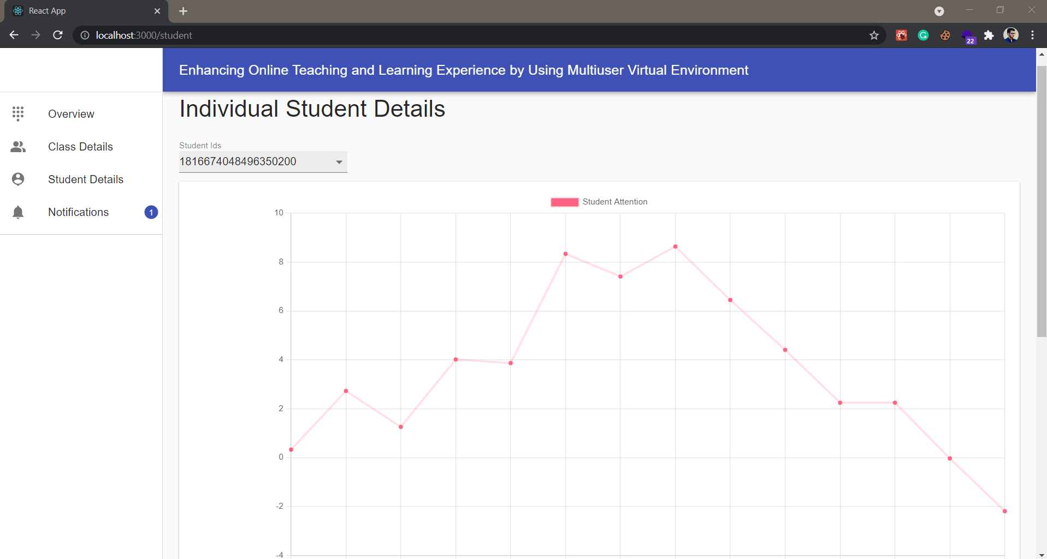
Progress up to Progress Presentation – 01 Contd.
IT18006544
Perera H.D.D.S
18

Slide 23
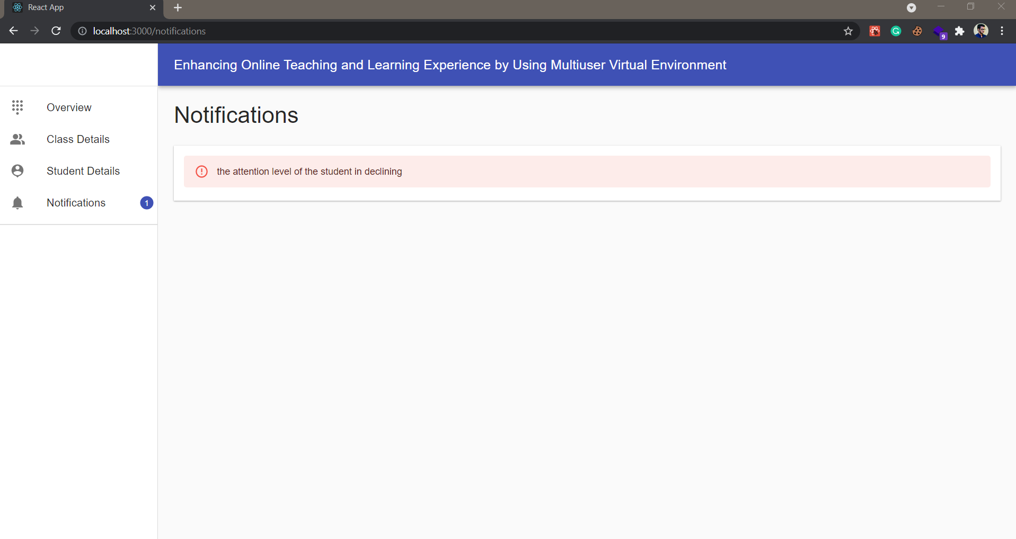
Progress up to Progress Presentation – 01 Contd.
IT18006544
Perera H.D.D.S
19

Slide 24
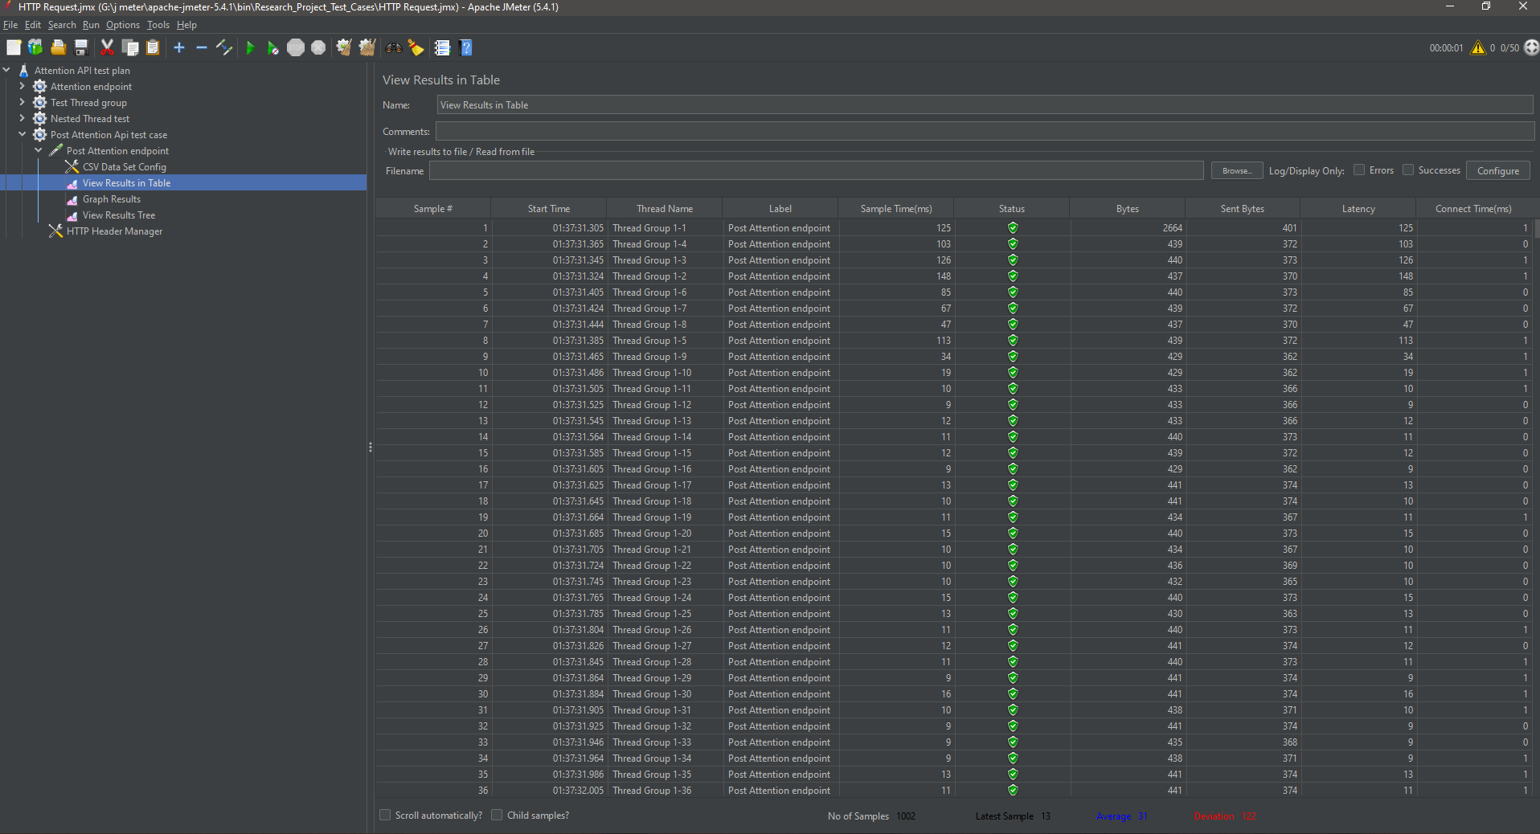
Progress up to Progress Presentation – 01 Contd.
IT18006544
Perera H.D.D.S
Load Testing – Tested
Stress Testing – To be tested
20

Slide 25
IT18006544
Perera H.D.D.S
Demonstrations
21

Slide 26
IT18001112
Tharaka W.C.M.K.
B.Sc. (Hons) Degree in Information Technology Specialization in Software Engineering

Slide 27
SUB OBJECTIVE - 02
Reducing students' isolation during online lectures and enabling the collaborative learning using multiuser virtual learning environment

Slide 28


Introduction
Previous situation: Students were studying together
IT18001112
Tharaka
W.C.M.K.
Present situation: Students are studying remotely
Collaborative learning
4 C’s of 21st Century Learning Skills [1]
Participation Metaphor [2]
Benefits of Collaborative learning [3]
22

Slide 29
Research Question
IT18001112
How to enable the Collaborative Learning in an efficient manner
while students are not in same place?
Tharaka
W.C.M.K.
How to reduce student isolation during online lectures?
23

Slide 30

Objectives
Enabling collaborative learning [1], [4]
IT18001112
Tharaka
W.C.M.K.
Build a Virtual Learning Environment to Increase the Immersiveness [5]
Build character models for students
Implement collaborative content editing (Brainstorming, Mind Mapping etc.)
Reducing student isolation during online lectures
Implement Voice communication channel
between a few numbers of friends
Implement QA Discussion board [4]
24

Slide 31
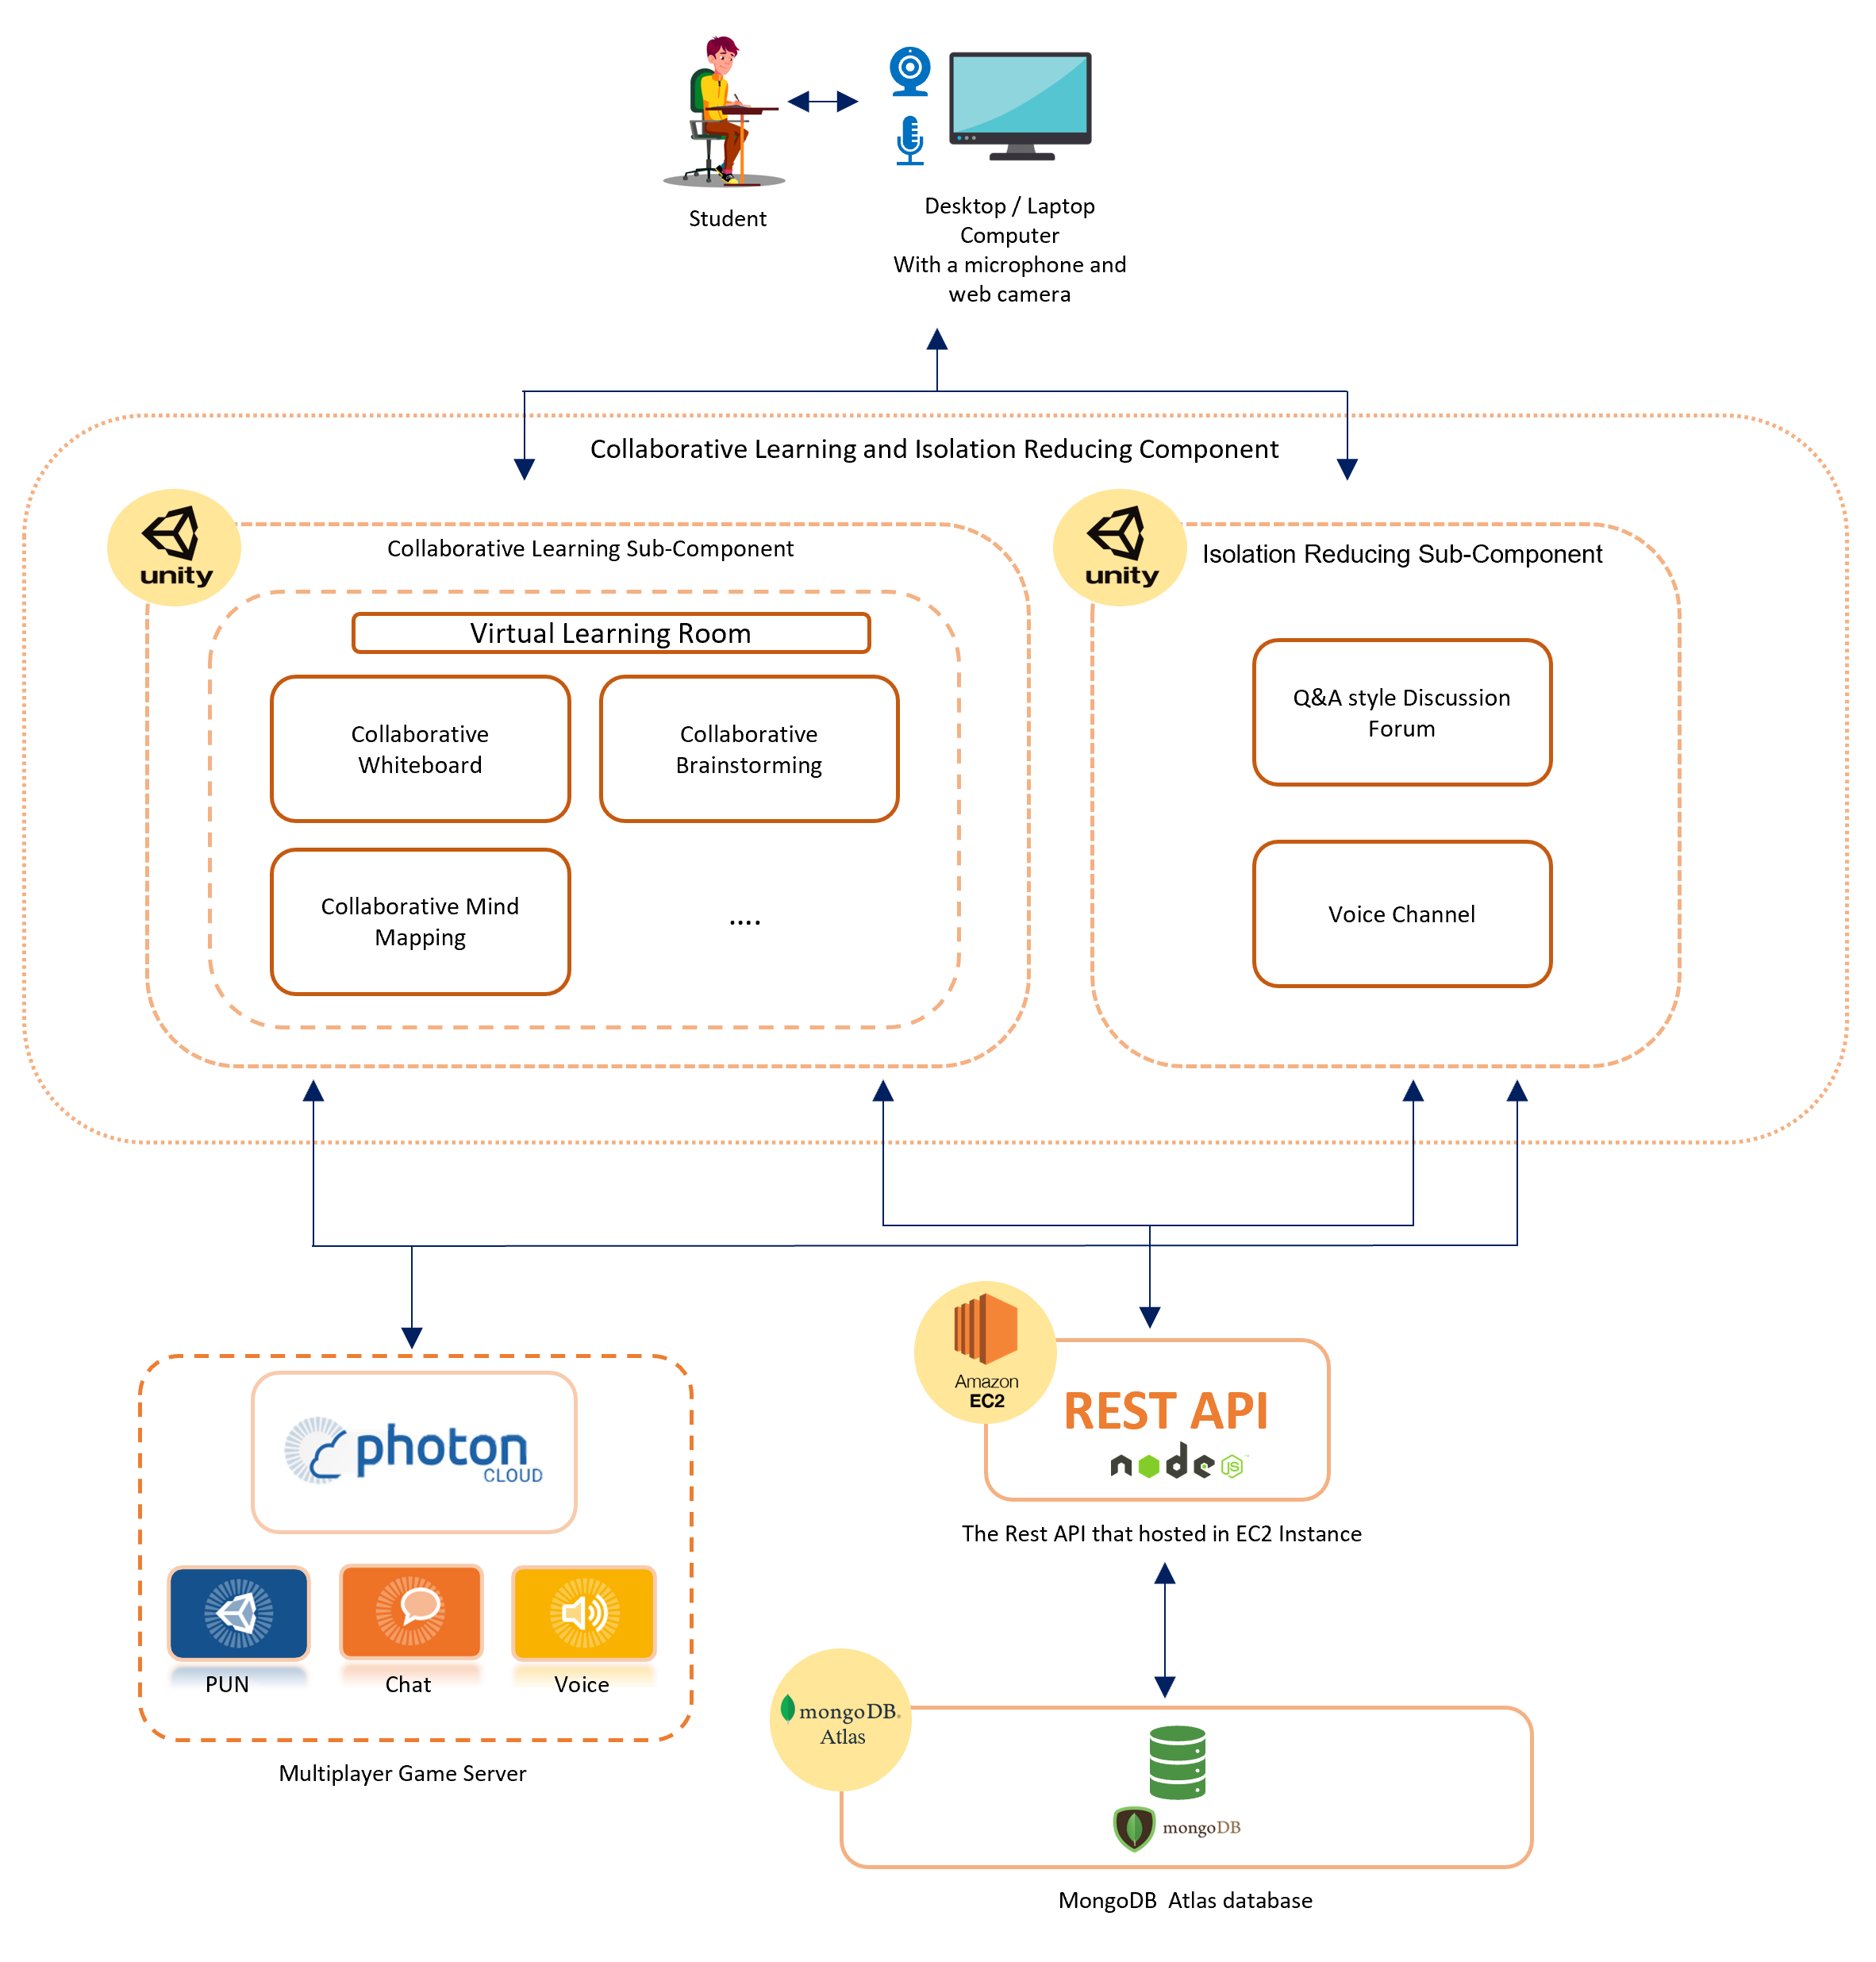
Overview Diagram and Technologies Used
IT18001112
Tharaka
W.C.M.K.
Unity Game Engine - Build the Virtual Environment
C# - Development language of Unity
Visual Studio IDE
Photon Unity Networking - Multiuser Development in Unity
Photon Voice - Multiuser Voice Communication
Photon Chat - Multiuser Message Communication
Mongo DB Atlas - Database
Node.JS, Express.JS - REST API
AWS EC2 cloud service - Cloud Sever
25

Slide 32
Functional & Non- Functional Requirements
Completed Functional Requirements
IT18001112
Multi user access to the Virtual Learning Environment
Tharaka
W.C.M.K.
Character model movement control
Student communication when they use Virtual Learning Environment
Remaining Functional Requirements
Collaborative content editing in the Virtual Learning Environment
QA discussion forum during the lectures [4]
Voice channel among few friends during the lectures
Non-Functional Requirements of the Component
Availability – Photon Cloud
Reusability - Reusable Prefabs, Materials, Textures…
26
Modifiability - Best practices in Unity Engine and Game development

Slide 33

Progress up to Progress Presentation-01
Virtual Room Environment
IT18001112
Basic Character Models
Tharaka
W.C.M.K.
Character Movements and Initial Animation Synchronization
Multiuser Access to the Environment
Multiuser Voice Communication
Multiuser Message Communication (In Progress)
27

Slide 34
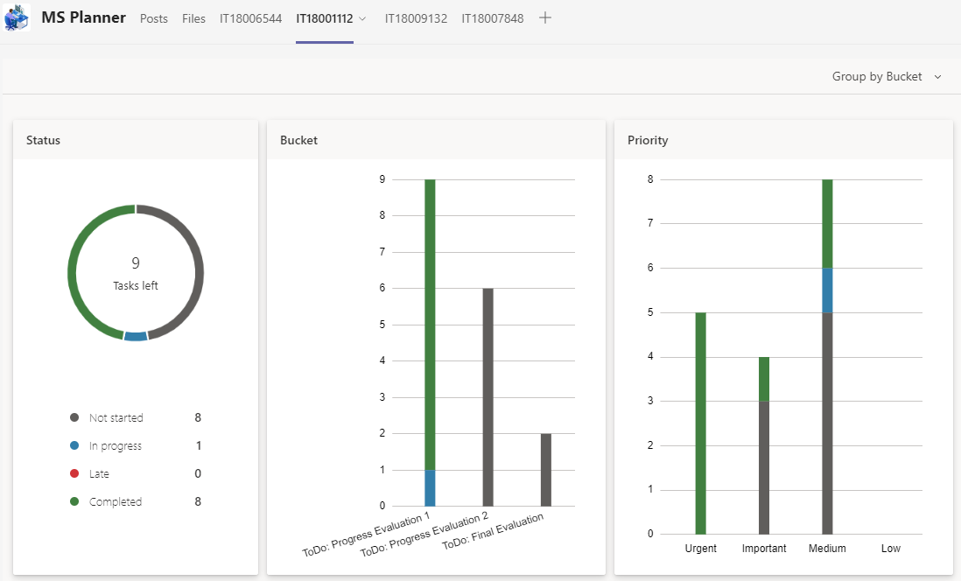
Progress up to Progress Presentation-01 Contd.
IT18001112
Tharaka
W.C.M.K.
28

Slide 35
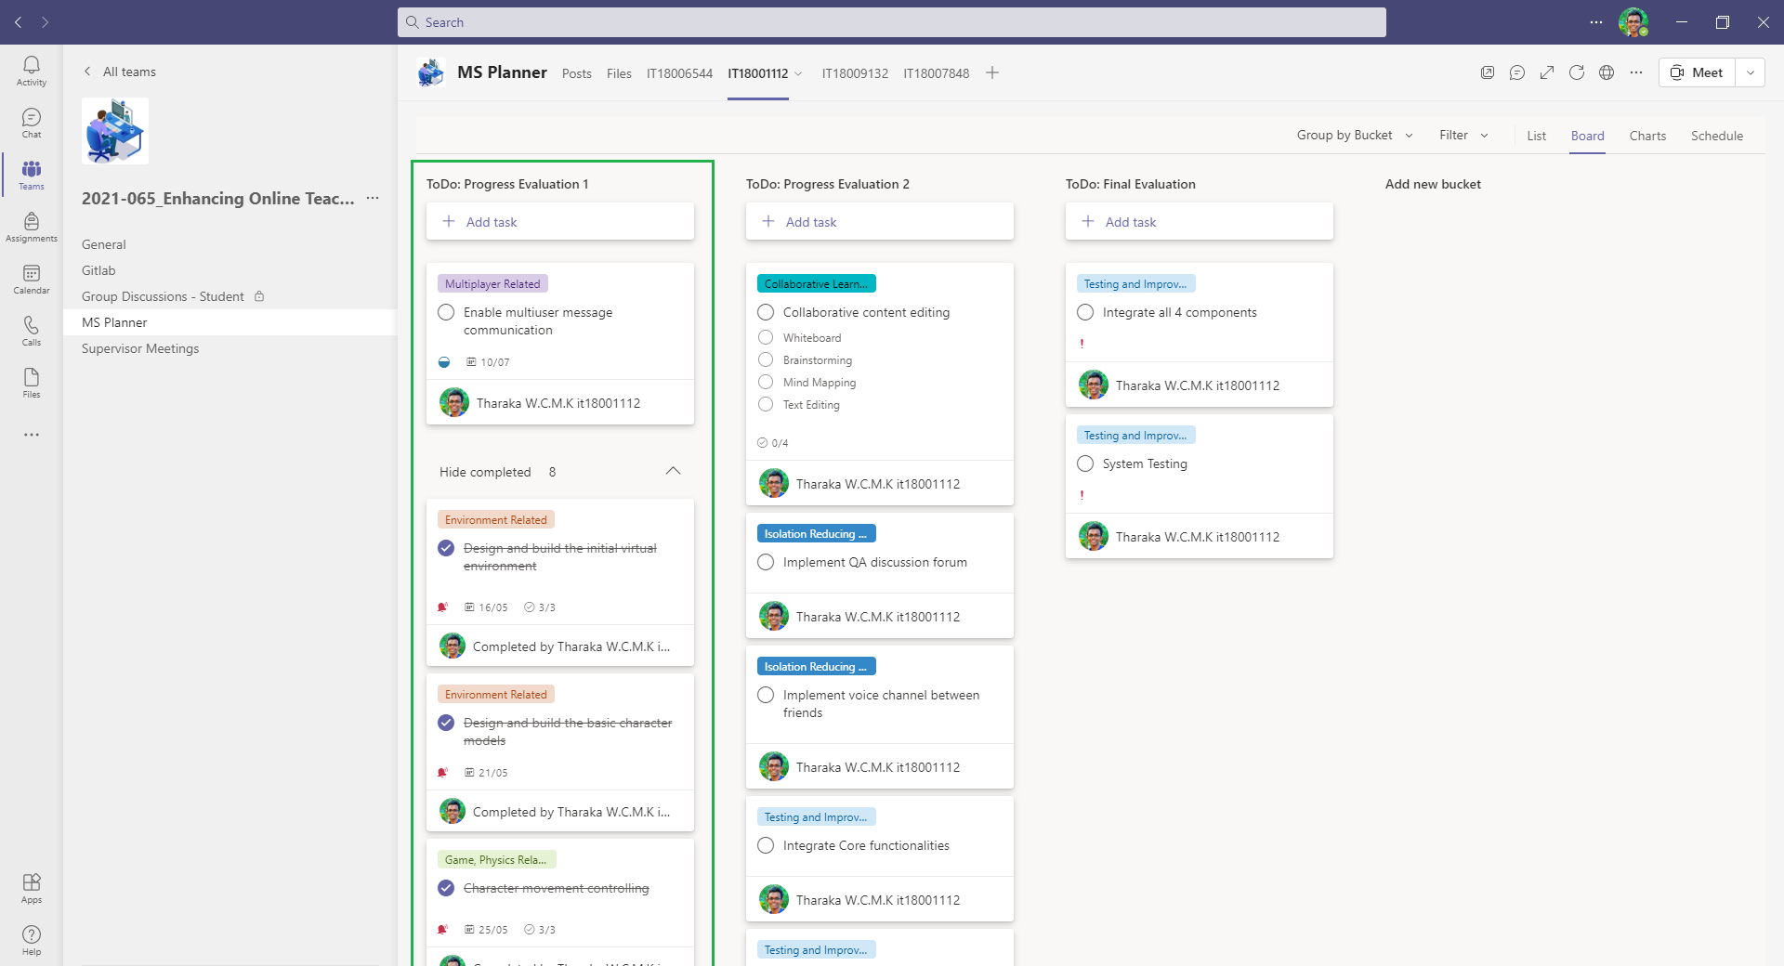
Progress up to Progress Presentation-01 Contd.
IT18001112
Tharaka
W.C.M.K.
29

Slide 36
Raised Problems and Risks
Data consumption in animation synchronization – Addressed
IT18001112
Tharaka
W.C.M.K.
Repeated sound in voice communication – Yet to be Addressed
Text chat communication - Two approaches – Yet to be Addressed
30

Slide 37
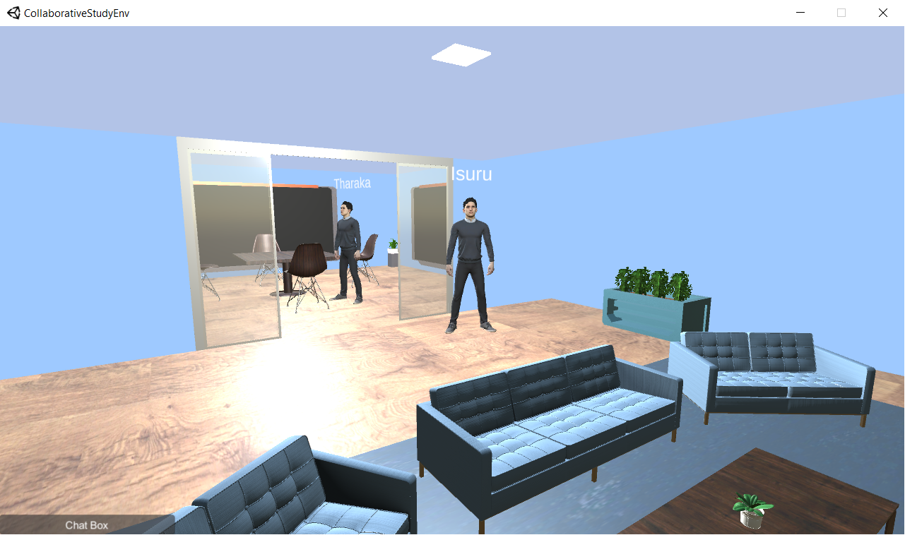
Progress up to Progress Presentation-01 Contd.
IT18001112
Tharaka
W.C.M.K.
31

Slide 38
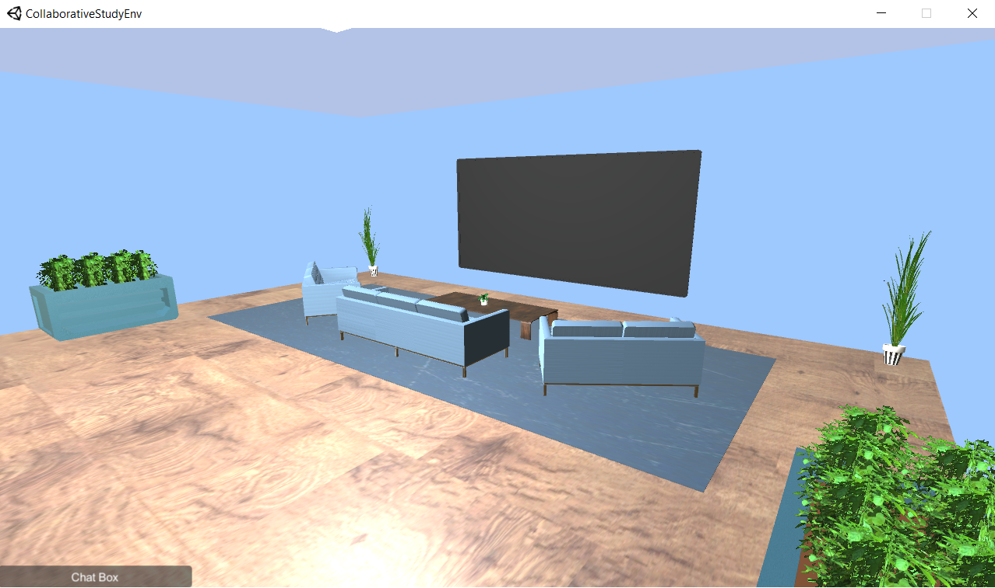
Progress up to Progress Presentation-01 Contd.
IT18001112
Tharaka
W.C.M.K.
32

Slide 39
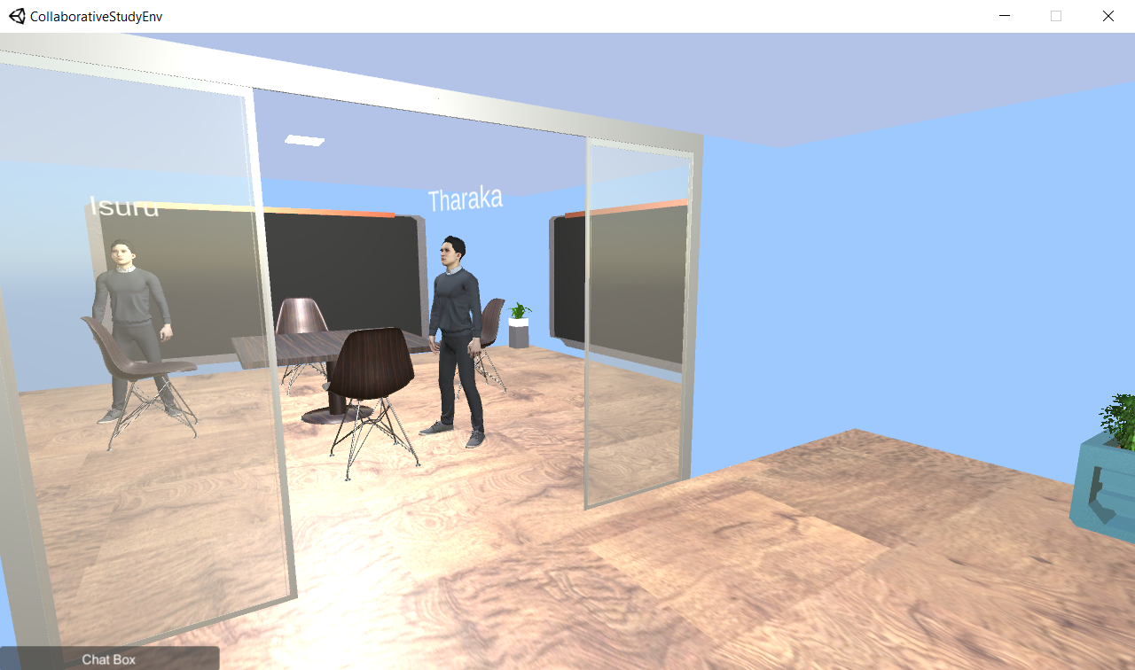
Progress up to Progress Presentation-01 Contd.
IT18001112
Tharaka
W.C.M.K.
33

Slide 40
References
[1] "What are the 4 C's of learning skills?", Newsroom.unl.edu.
[Online]. Available: https://newsroom.unl.edu/announce/csmce/5344/29195 [Accessed: 26 June 2021]
IT18001112
Tharaka
W.C.M.K.
[2] A.Sfard, “On Two Metaphors for Learning and the Dangers of Choosing Just One,”
Educ. Res., vol. 27, no. 2, p. 4, 1998, doi: 10.2307/1176193.
[3] M. Laal and S. M. Ghodsi, "Benefits of collaborative learning," in Procedia -
Social and Behavioral Sciences, Jan. 2012, vol. 31, pp. 486–490, doi: 10.1016/j.sbspro.2011.12.091.
[4] D. Wahyuningsih, “Active Learning Through Discussion in E-Learning,” Int. J. Act. Learn., vol. 1, no. 1, pp. 1–4, 2016, doi: 10.15294/ijal.v1i1.7733.
[5] S. H. Kweon, H. J. Kweon, S. Kim, X. Li, X. Liu, and H. L. Kweon,
“A Brain Wave Research on VR (Virtual Reality) Usage: Comparison Between
VR and 2D Video in EEG Measurement,” in Advances in Intelligent Systems and Computing,
Springer International Publishing, 2017, pp. 194–203. doi: 10.1007/978-3-319-60366-7_19.
34

Slide 41
IT18001112
Tharaka
W.C.M.K.
Demonstration
35

Slide 42
IT18009132
Dilanka R.M.T.
B.Sc. (Hons) Degree in Information Technology Specialization in Software Engineering

Slide 43
SUB OBJECTIVE - 03
Providing a near-real time, simulated student behavioral view of the students

Slide 44
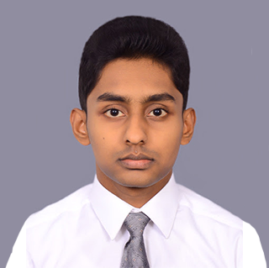
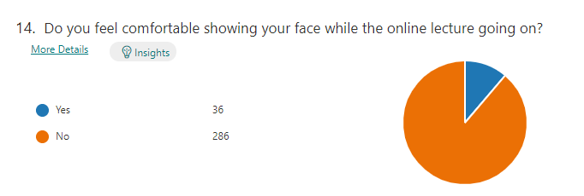
Background and Research Gap
IT18009132
students are reluctant to expose their faces and backgrounds to the other attendees during the online lecture
Dilanka R.M.T.
88%
lecturer cannot see the students' live reactions and engagement
Feel less motivation
Maintaining students’ attention is more challenging
36
Observe all the student behaviours in a screen is not practical

Slide 45
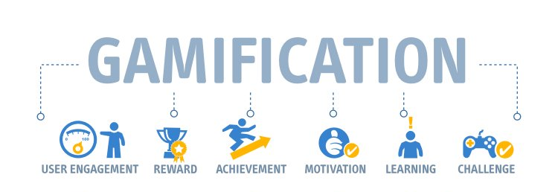
Background and Research Gap
IT18009132
Apply Gamification Concepts to online teaching
Dilanka R.M.T.
37

Slide 46
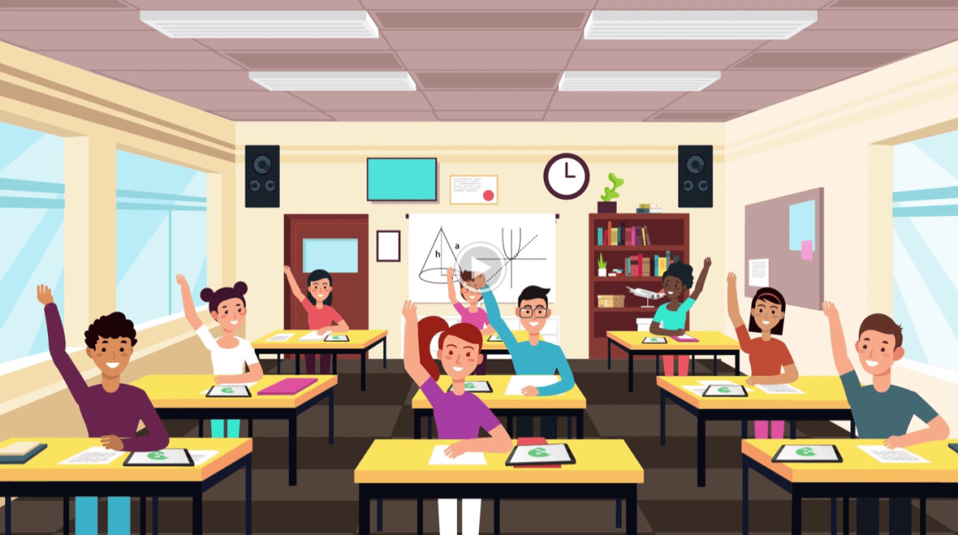
Research Problem
IT18009132
Providing the feature for the lecturers to observe the live behavior of the students while protecting the privacy
Dilanka R.M.T.
38

Slide 47
Research Question
IT18009132
How to use Gamification concepts in online teaching
Dilanka R.M.T.
How to create the experience of a real classroom for lecturers
How to enable separate voice channels between group of students
39

Slide 48
Objectives
IT18009132
Providing a near-real time, simulated students' behavioral view to the lecturer
Dilanka R.M.T.
Build the Virtual Class Room Environment
Build Student Representational Models With Facial Expressions and Behaviours
Capture Students’ Hand Gestures
Enable separate voice communication between lecturer and selected student group
40

Slide 49
System, Software and Personnel Requirements
IT18009132
Functional Requirements
Dilanka R.M.T.
Virtual classroom with near real-time student behaviours
Attentiveness of each student and Overall class room status
Lecturer should notify if most students got confused at a point
Student engagement report though out the lecturer
Non-Functional Requirements
Availability
Reusability
Scalability
Useability
41

Slide 50
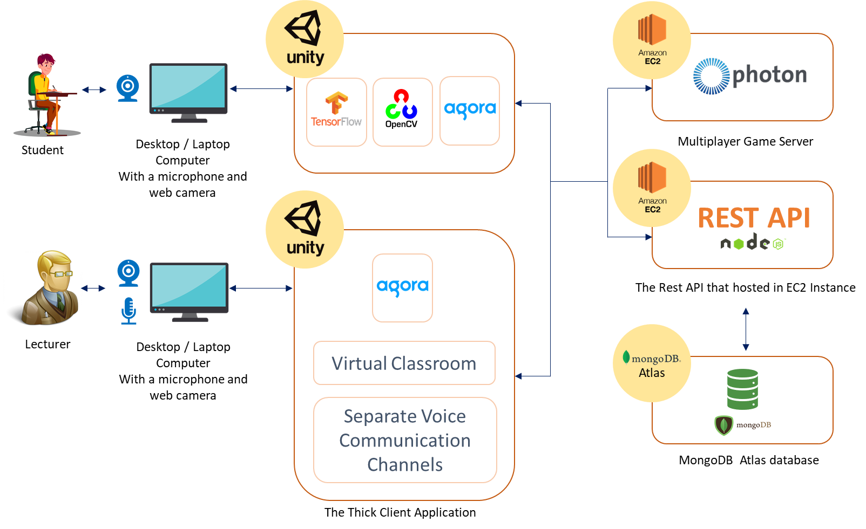
System Overview Diagram
IT18009132
Dilanka R.M.T.
42

Slide 51
Technologies
IT18009132
Unity Game Engine - Build the Virtual Environment
Dilanka R.M.T.
C# - Development language of Unity
Visual Studio IDE
Photon Unity Networking - Multiuser Development in Unity
Agora - Enable voice communication between lecturer and students
Mongo DB Atlas - Database
Node.JS, Express.JS - REST API
AWS EC2 cloud service - Cloud Sever
43

Slide 52
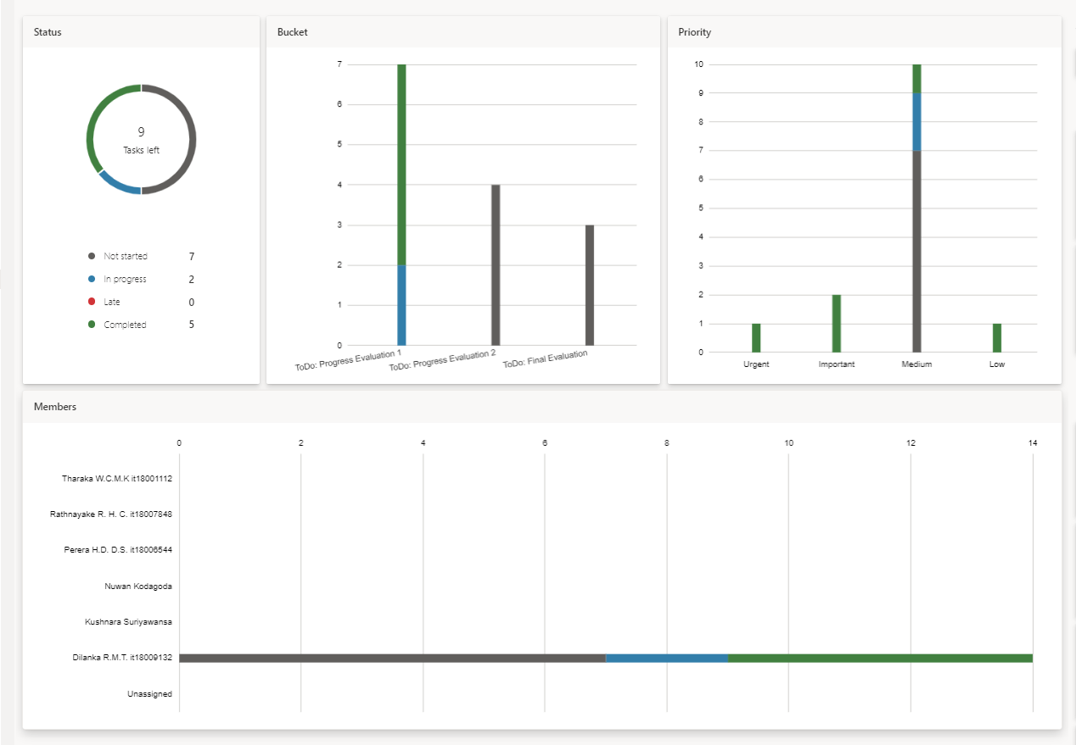
Progress up to Progress Presentation-01
IT18009132
Dilanka R.M.T.
45

Slide 53
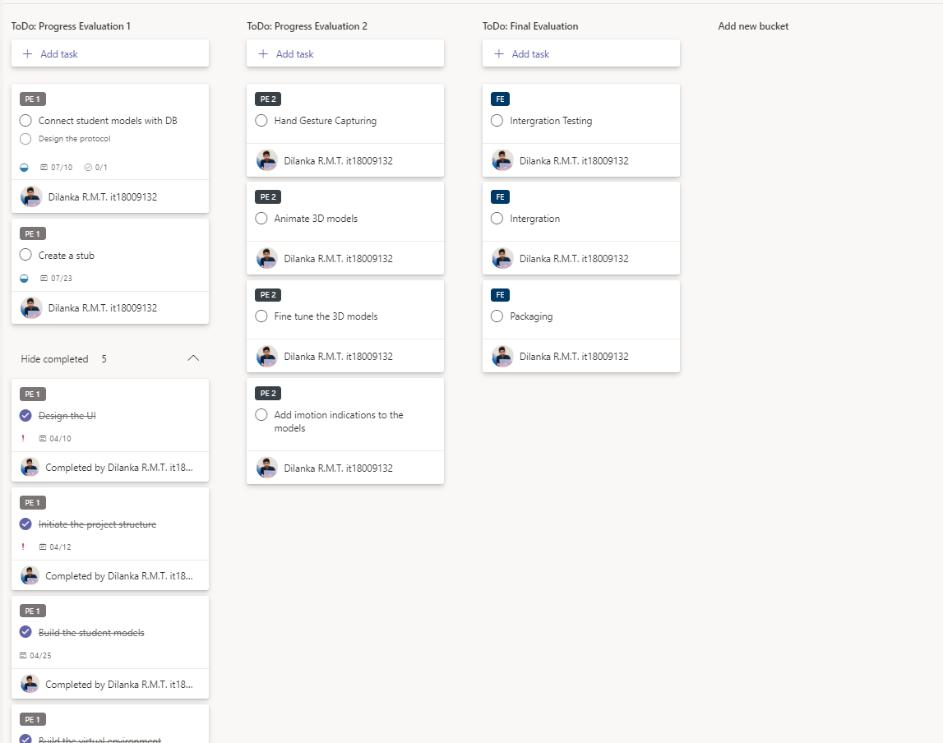
Progress up to Progress Presentation-01 contd.
IT18009132
Dilanka R.M.T.
46

Slide 54

Progress up to Progress Presentation-01 contd.
IT18009132
Completed
Dilanka R.M.T.
UI Design
Create the lecture hall scene
Develop an API-Stub to mock the database connectivity
Create basic student models
Setup lighting and Physical behaviors in the environment
In Progress
Dynamically Render the student models to the view
47

Slide 55
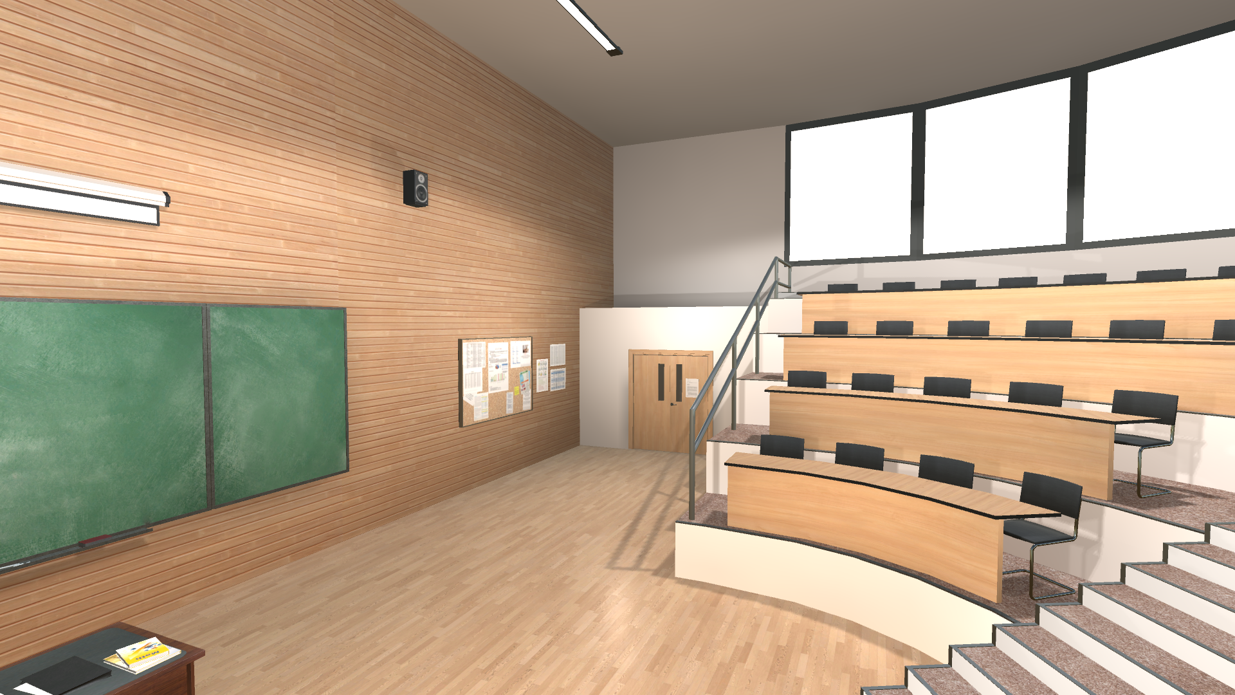
Progress up to Progress Presentation-01 contd.
IT18009132
Dilanka R.M.T.
48

Slide 56
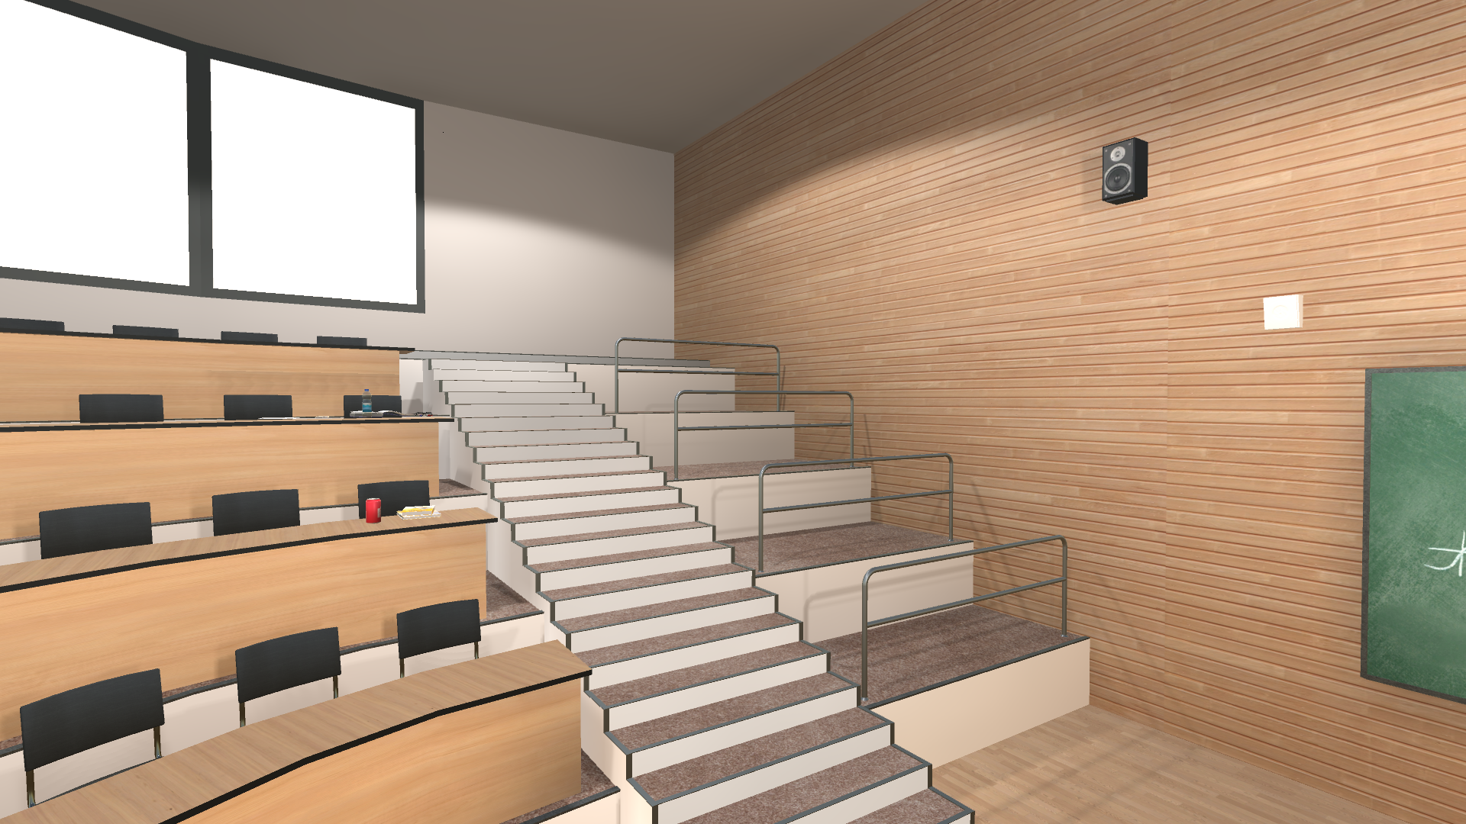
Progress up to Progress Presentation-01 contd.
IT18009132
Dilanka R.M.T.
49

Slide 57
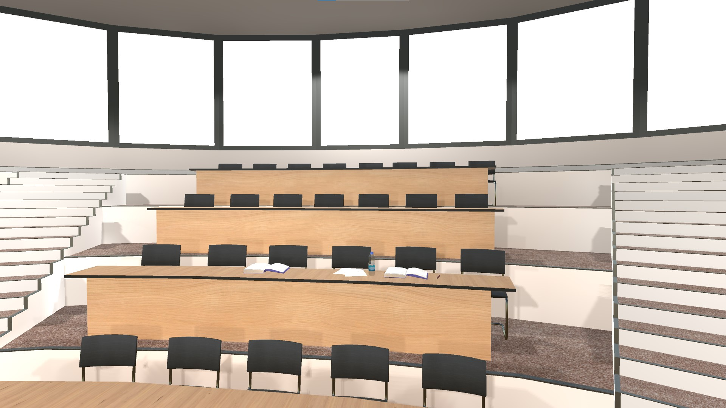
Progress up to Progress Presentation-01 contd.
IT18009132
Dilanka R.M.T.
50

Slide 58
IT18009132
Dilanka R.M.T.
Demonstration
51

Slide 59
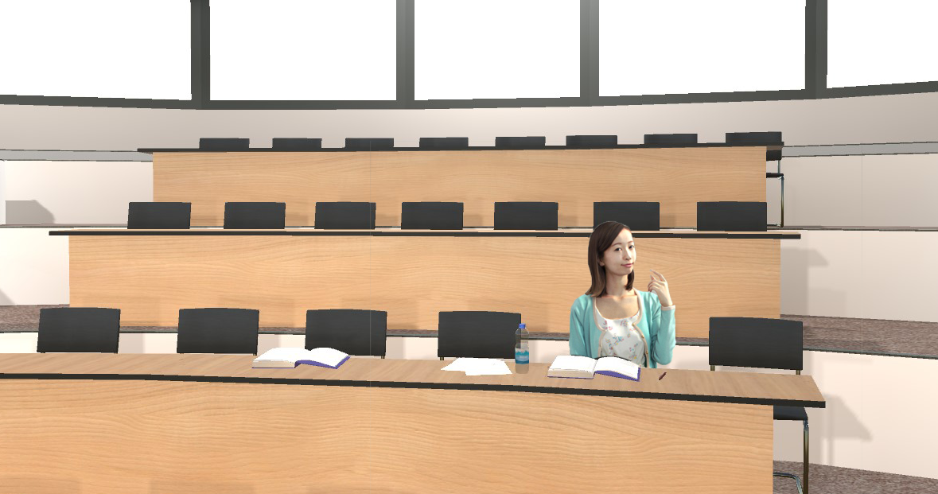
Prototype image of the final view
IT18009132
Dilanka R.M.T.
98%
Andrea
Attentiveness
52

Slide 60
Prototype image of the final view
IT18009132
Dilanka R.M.T.
76%
Andrea
Attentiveness
52

Slide 61
Prototype image of the final view
IT18009132
Dilanka R.M.T.
42%
Andrea
Attentiveness
52

Slide 62
References
[1] Titan, Ferdianto, G. G. F. P. Desak and Lena, "A comparative study of teaching styles in online learning environment," 2017 International Conference on Information Management and Technology (ICIMTech), Special Region of Yogyakarta, Indonesia, 2017, pp. 25-30, doi: 10.1109/ICIMTech.2017.8273505.
[2] D. Preuveneers and W. Joosen, "Edge-Based and Privacy-Preserving Multi-Modal Monitoring of Student Engagement in Online Learning Environments," 2019 IEEE International Conference on Edge Computing (EDGE), Milan, Italy, 2019, pp. 18-20, doi: 10.1109/EDGE.2019.00017.
[3] M. Atherton, M. Shah, J. Vazquez, Z. Griffiths, B. Jackson, and C. Burgess, “Using learning analytics to assess student engagement and academic outcomes in open access enabling programmes,” Open Learning: The Journal of Open, Distance and e-Learning, vol. 32, no. 2, pp. 119–136, 2017
[4] W. S. Yue, "Enhancement of Learning Management System (LMS) by serious game engine: Collaborative," 2015 4th International Conference on Interactive Digital Media (ICIDM), Bandung, Indonesia, 2015, pp. 1-5, doi: 10.1109/IDM.2015.7516323.
IT18009132
Dilanka R.M.T.
53

Slide 63
IT18007848
Rathnayake R.H.C.S.
B.Sc. (Hons) Degree in Information Technology Specialization in Software Engineering

Slide 64
SUB OBJECTIVE - 04
Use of speech recognition model to transcribe and fine-tune the lecturer speech during an online lecture

Slide 65
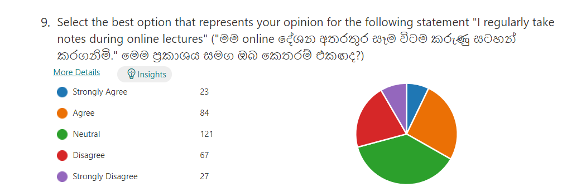
Background and Research Gap
IT18007848
Students are tended not to take lecture notes in online lectures
Rathnayake
R.H.C.S
There is no lecture note generation tool currently available in the
The E-learning domain
There is a limited number of researches of domain-specific training
on speech recognition models.
54

Slide 66
Research Question
IT18007848
How to help students with special needs to take an accurate lecture note ?
Rathnayake
R.H.C.S
How to provide a well-organized lecture note with important figures
of the conducted lecture ?
55

Slide 67
Objectives
IT18007848
Use of speech recognition model to transcribe and fine-tune the lecturer speech
Rathnayake
R.H.C.S
Train an image recognition model to identify the visual figures of the lecture
and to extract important figures from the lecture slides
Organize the optimized lecture transcription with related visual figures
in order to generate a lecture note.
56

Slide 68
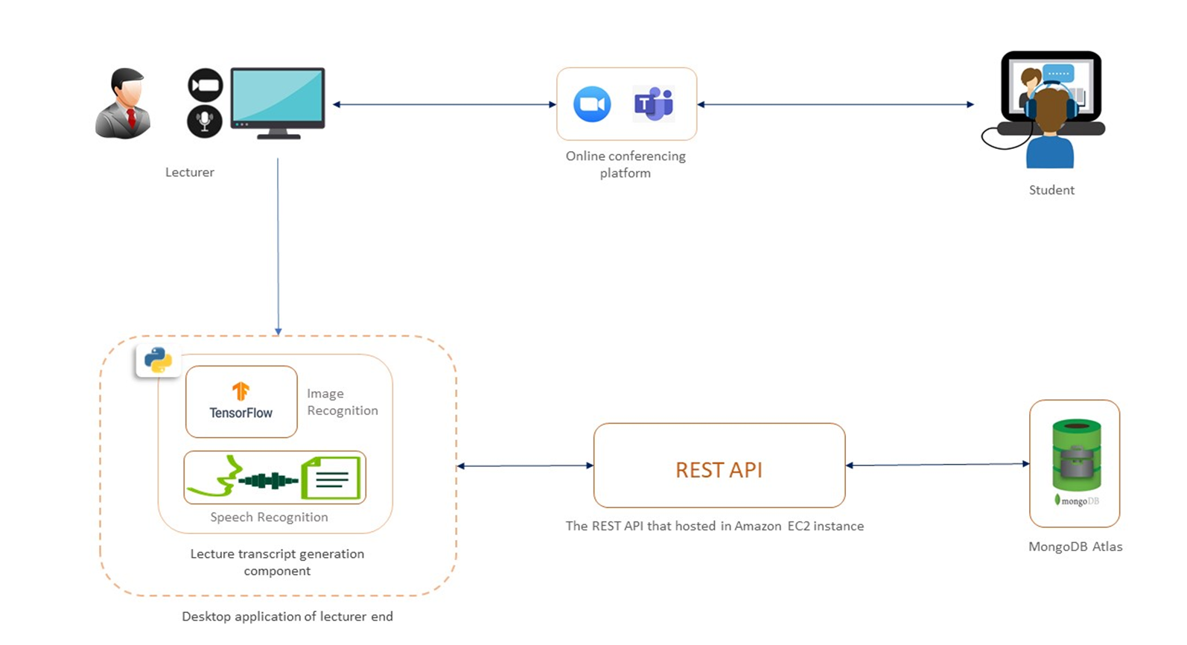
System Diagram for lecturer note generator
IT18007848
Rathnayake
R.H.C.S
Mozilla DeepSpeech as speech recognition model
Python
TensorFlow
Open cv for image recognition
Google Collab – to computation power to train
machine learning models
Mongo DB Atlas - Database
Node.JS, Express.JS – Web socket server and REST APIs
AWS EC2 cloud service - Cloud Sever
57

Slide 69
System, Software and Personnel Requirements
IT18007848
Functional Requirements of the Component
Rathnayake
R.H.C.S
Support for real time transcription of lecturer speech into text
Model should be able to perform transcribing when hosted on a web socket server
Should be able to detect and extract important visual figures of the lecture
Should be able to deliver summarized and well organized lecture note at the end
Non-Functional Requirements of the Component
Availability - AWS EC2
Usability - use with different conferencing platforms
58

Slide 70
Work Breakdown Structure
Lecture Note Generator Component
Research Initiation
Form the group
Select a Research Area and a Research Topic
Present Research Topic to the Supervisors
Study about existing work
Feasibility study
Primary Survey
Secondary Survey
Finalizing the Topic
Research Topic Assesment and Project Charter
Study the Research Background Further
Identify the Problems more Specifically
Identify the Objectives
Identify the Research Components
Create and Submit the Topic Assesment Document
Refine the Topic Assesment Document
Create and Submit the Charter Document
Research Proposal
Document Literature Review
Document Research Gap
Document the Objectives
Document Methodology
Document the Predicte Budget
Document the Commercial Value
Create and Submit the Proposal Report
Proposal Presentation
Progress
Presentation I
Implement the speech recognition part
fine tune speech recognition model
web-socket server for speech recoginitin model
sample UI to display transcription
improve accuracy
Progress
Presentation II
Summarize the transcription
Implement image recognition part
implement lecture note organizing part
Refine the UI and UX
Integrate Core functionalities and other components
Test the whole component
Final Reports
Document the Research Outcomes
Create and Submit Reearch Papers
Submit Final Report
Final Assesment
Integrate with other Research Components
Integration and System Testing
Finalize all Deliverables
Deploy the System
Final Presentation
IT18007848
Rathnayake
R.H.C.S
59

Slide 71
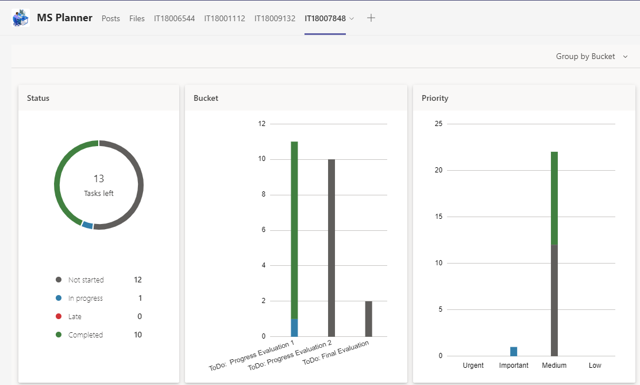
Progress up to Progress Presentation-01
IT18007848
Rathnayake
R.H.C.S
60

Slide 72
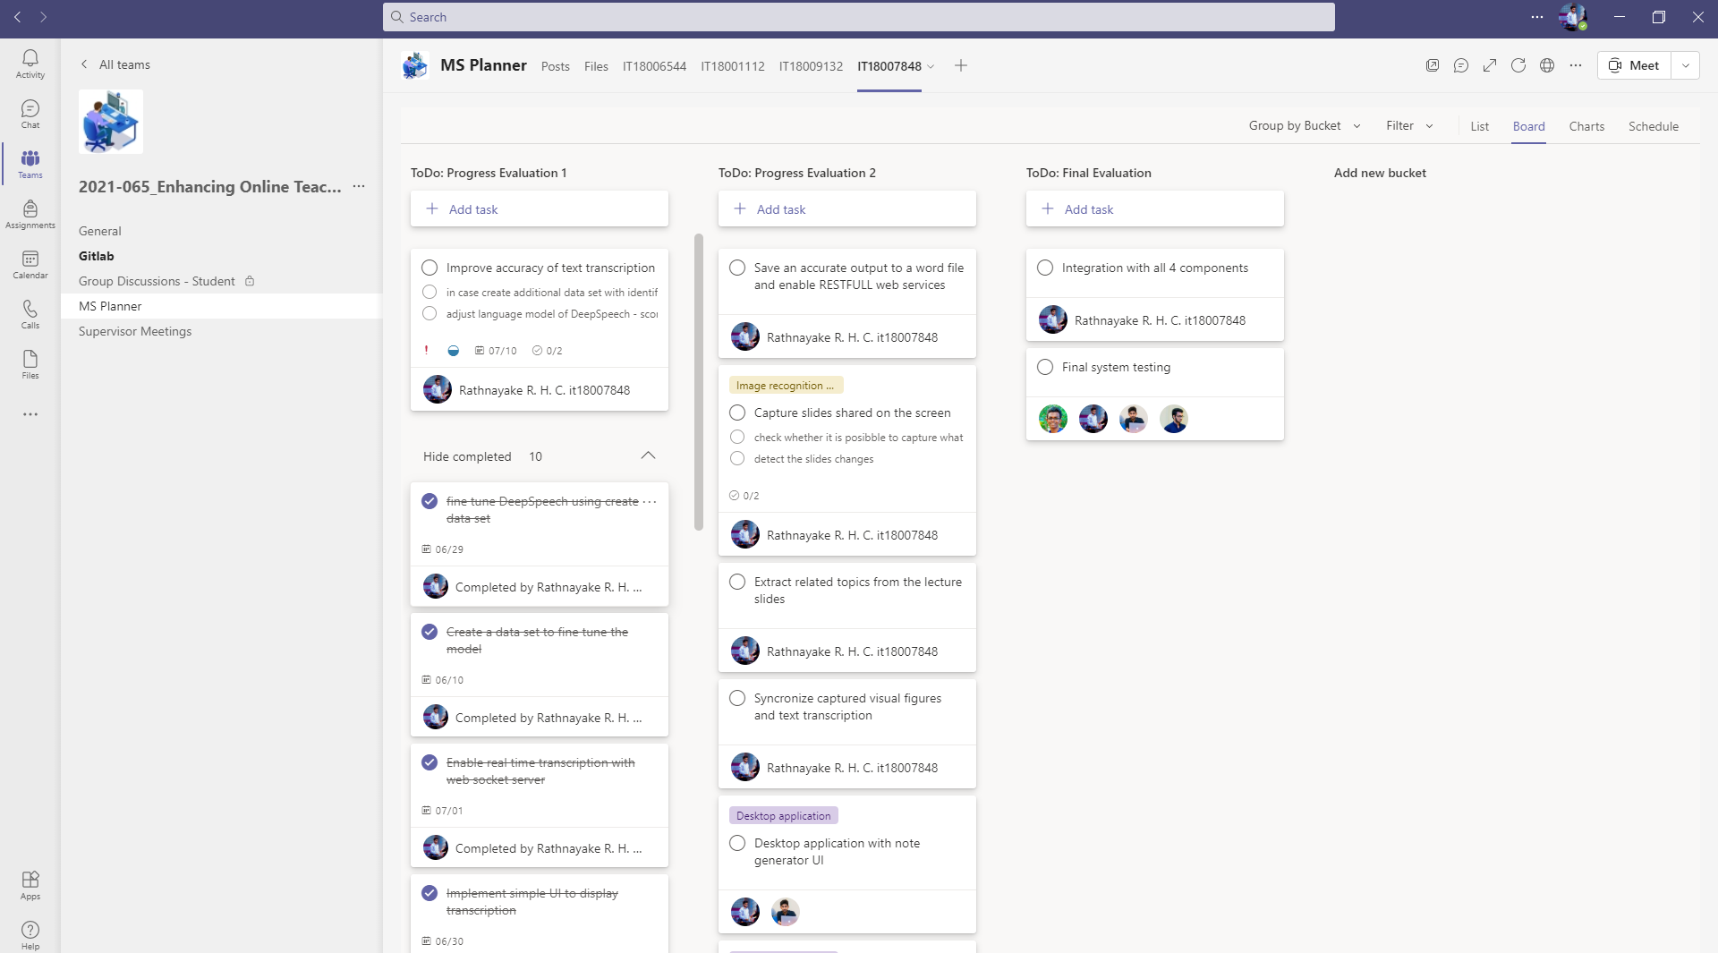
Progress up to Progress Presentation-01 Contd.
IT18007848
Rathnayake
R.H.C.S
61

Slide 73
Progress up to Progress Presentation-01 Contd.
IT18007848
Train suitable speech recognition model
Rathnayake
R.H.C.S
Fine tune it for Sri Lankan accent
Web socket server to host the trained model
Enable real time transcription
Sample UI to display the out-put
Increase the accuracy of the transcription and summarize (In Progress)
62

Slide 74
Problems and Risks that were raised
YTBA - Yet To Be Addressed
IT18007848
Rathnayake
R.H.C.S
AA - Addressed Already
How to enable real-time communication with a hosted model and client - AA
Improve the accuracy of the lecture transcript - YTBA
Summarize the lecture transcript - YTBA
63

Slide 75
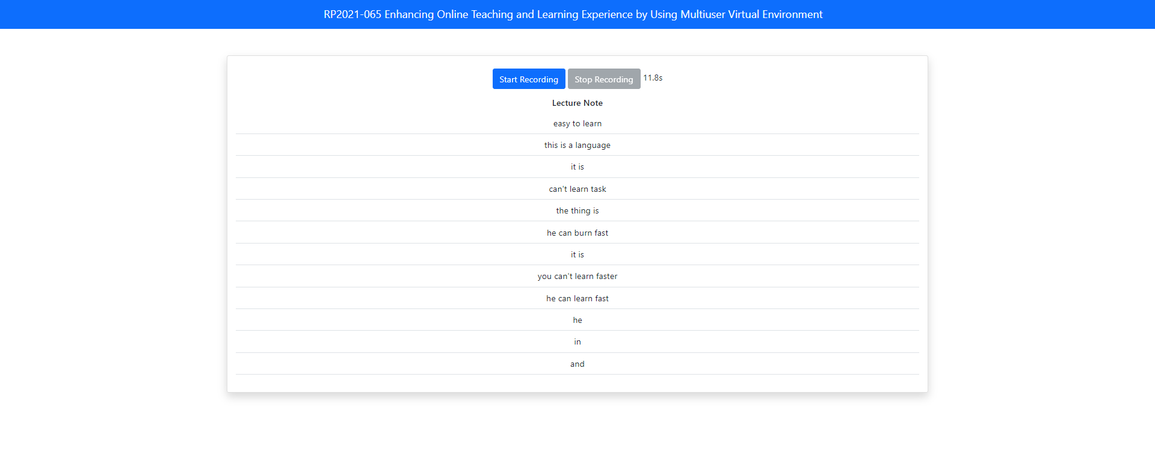
Progress up to Progress Presentation-01 Contd.
IT18007848
Rathnayake
R.H.C.S
64

Slide 76
References
[1] Ranchal, Rohit & Doughty, Teresa & Guo, Yiren & Bain, Keith & Martin, Heather &
Robinson, Joseph & Duerstock, Bradley. (2013). Using Speech Recognition for
Real-Time Captioning and Lecture Transcription in the Classroom. Learning Technologies,
IEEE Transactions on. 6. 299-311. 10.1109/TLT.2013.21.
IT18007848
Rathnayake
R.H.C.S
[2]Boyle, Joseph & Forchelli, Gina & Cariss, Kaitlyn. (2015). Note-Taking Interventions to Assist Students With Disabilities in Content Area Classes. Preventing School Failure. 1-10. 10.1080/1045988X.2014.903463.
[3]Wiley, J. Picture this! Effects of photographs, diagrams, animations, and sketching on learning and beliefs about learning from a geoscience text. Appl Cognit Psychol. 2019; 33: 9– 19. https://doi.org/10.1002/acp.3495
[4]Wald, M. (n.d.). Using Automatic Speech Recognition to Enhance Education for All Students: Turning a Vision into Reality. Proceedings Frontiers in Education 35th Annual Conference. doi:10.1109/fie.2005.1612286
[5]Wald, M., & Li, Y. (2012). Synote: Important Enhancements to Learning with Recorded Lectures. 2012 IEEE 12th International Conference on Advanced Learning Technologies. doi:10.1109/icalt.2012.8
65

Slide 77
IT18007848
Rathnayake
R.H.C.S
Demonstration
66

Slide 78
Standards & Best Practices
Coding Conventions - Python, C#, JavaScript
IT18007848
Rathnayake
R.H.C.S
Version Controlling Best Practices
Branching conventions
Maintaining separate branches for different environments – Dev, PreProd, Prod
Commit message conventions
67

Slide 79
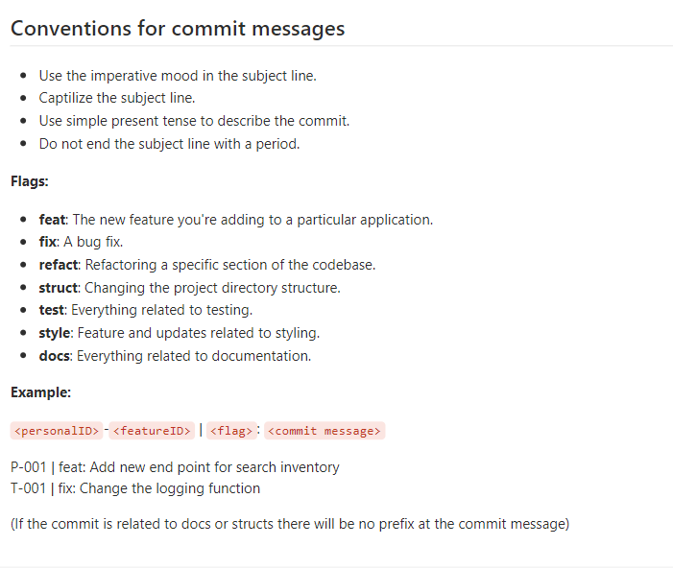
Standards & Best Practices
IT18007848
Rathnayake
R.H.C.S
68

Slide 80
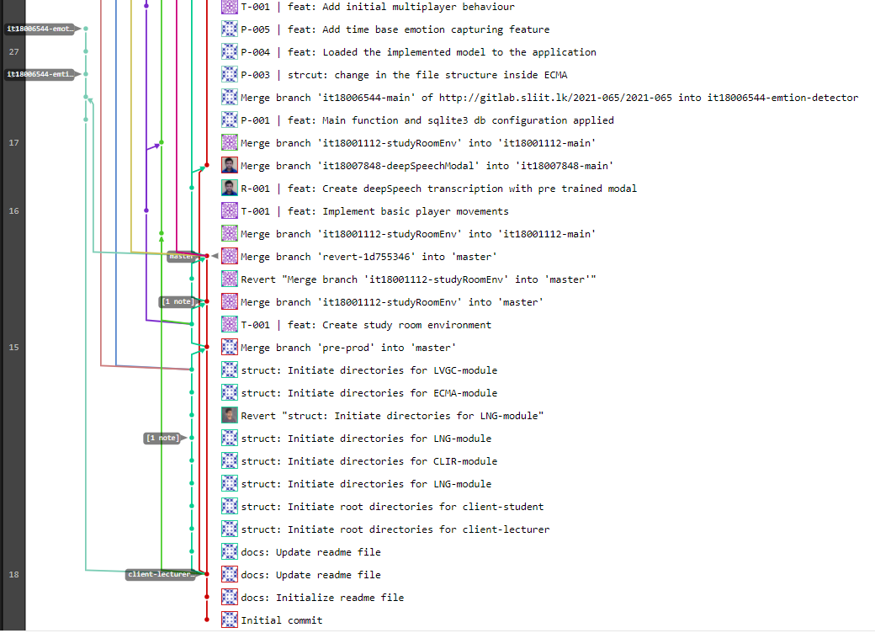
Standards & Best Practices
IT18007848
Rathnayake
R.H.C.S
69

Slide 81
Product Marketing and Commercialization Plan

Slide 82

Marketing Commercialization Plan
Targeted Audience
IT18007848
Rathnayake
R.H.C.S
Educational Institutes
Users: Lecturers and Students
Benefits
Students’ attention can be identified even if the student does not expose their identity to the lecturer
No need of using many tools to do collaborative learning
Students who are doing jobs with education will be able to save their time
Can help students who have hearing and physical impairments
70
Other existing solutions does not provide lecture note feature

Slide 83
Marketing Commercialization Plan
Advertising and Communication
IT18007848
Rathnayake
R.H.C.S
YouTube Channel
Facebook Page
Social Media Advertisements
71

Slide 84
Pricing Strategy
IT18007848
Student Attention level Detecting Tool
Virtual Classroom View With Attention Level Indicator
Student Attention level Detecting Tool
Virtual Classroom View With Attention Level Indicator
Attention Level Notification
Lecture Note Tool
Student Attention level Detecting Tool
Virtual Classroom View With Attention Level Indicator
Lecture Engagement Report
Attention Level Notification
Collaborative Learning Room
Lecture Note Tool
Rathnayake
R.H.C.S
Free
Standard
Premium
72

Slide 85

THANK YOU!

